Slide 1
Workshop Security
SQL Server & GDPR

Slide 2



Gianluca Hotz
Gianluca Hotz | @glhotz | ghotz@ugiss.org
Fondatore e Mentor SolidQ
  20+ anni con SQL Server (dalla 4.21 nel 1996)
  Modellazione basi di dati, dimensionamento e amministrazione, sviluppo, ottimizzazione
Interessi
  Modello relazionale, architettura DBMS, alta disponibilità e Disaster Recovery
Community
  20 anni Microsoft MVP SQL Server (dal 1998)
  Fondatore e presidente UGISS
    User Group Italiano SQL Server (PASS Chapter)

Slide 3
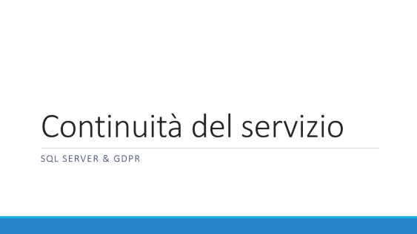
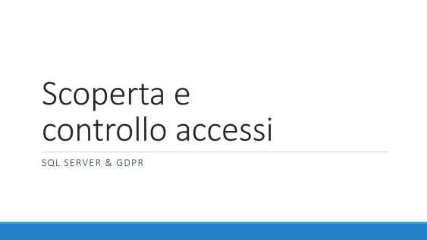
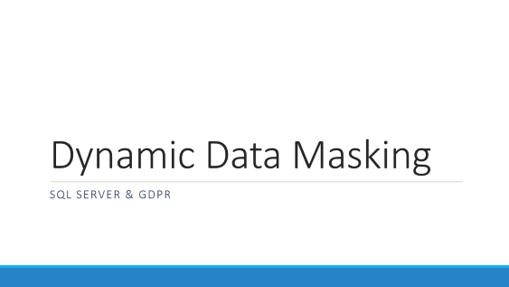
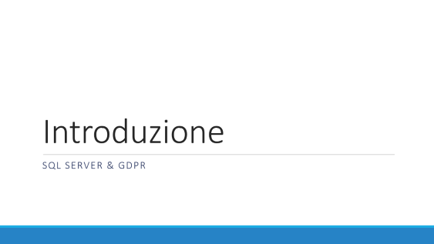
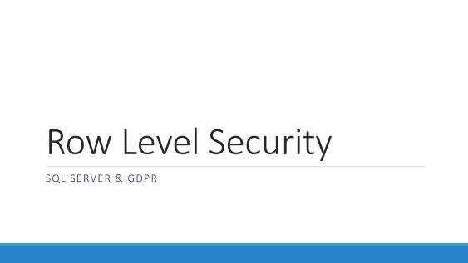
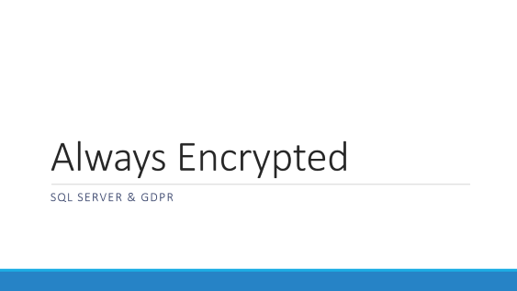
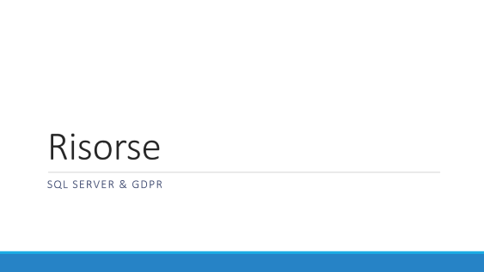
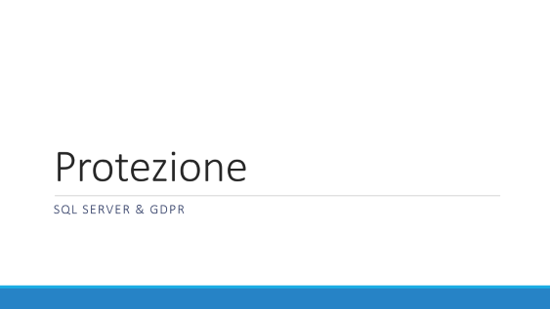
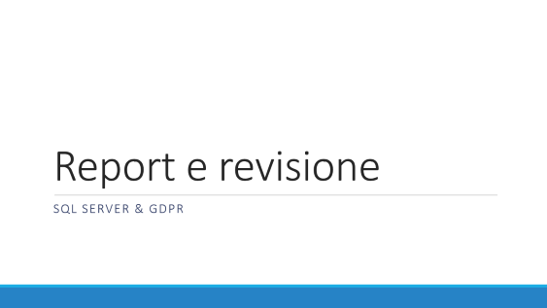

Slide 4
Introduzione
SQL Server & GDPR

Slide 5
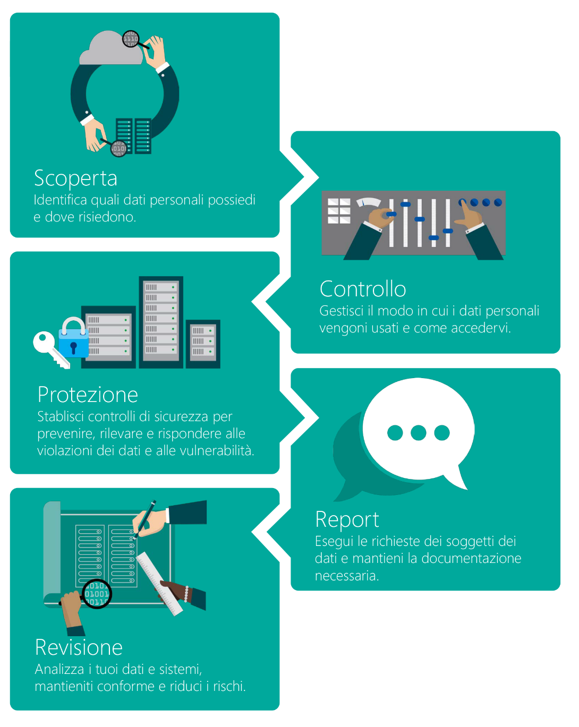
GDPR: General Data Protection Regulation
Normativa Europea (no direttiva!)
Chiunque tratti dati di residenti EU
Sanzioni 4% del fatturato o 20mio
25 Maggio 2018 (dopodomani!)
Codici di condotta per Micro/PMI
Approccio strutturato
Notes:
Personal data in scope with GDPR examples:
Name
Identification number
Email address
Online user identifier
Social media posts
Physical, physiological, or genetic information
Medical information
Location
Bank details
IP address
Cookies
GDPR Article 25—“Data protection by design and default”: Control exposure to personal data.
Control accessibility—who is accessing data and how.
Minimize data being processed in terms of amount of data collected, extent of processing, storage period, and accessibility.
Include safeguards for control management integrated into processing.
GDPR Article 32—“Security of processing”: Security mechanisms to protect personal data.
Employ pseudonymization and encryption.
Restore availability and access in the event of an incident.
Provide a process for regularly testing and assessing effectiveness of security measures.
GDPR Article 33—“Notification of a personal data breach to the supervisory authority”:
Detect and notify of breach in a timely manner (72 hours).
Detect breaches.
Assess impact on and identification of personal data records concerned.
Describe measures to address breach.
GDPR Article 30—“Records of processing activities”: Log and monitor operations.
Maintain an audit record of processing activities on personal data.
Monitor access to processing systems.
GDPR Article 35—“Data protection impact assessment”: Document risks and security measures.
Describe processing operations, including their necessity and proportionality.
Assess risks associated with processing.
Apply measures to address risks and protect personal data, and demonstrate compliance with the GDPR.

Slide 6
Security Layering
Data Encryption
Proactive monitoring
Access Control
Data Access
Data Encryption
Transparent Data Encryption (at rest)
Cell-Level Encryption (at rest)
Always Encrypted (at rest and in transit)
Data Access
Dynamic Data Masking
Row-Level Security
Access Control
Encrypted Authentication
SQL Firewall*
Proactive monitoring
Auditing
Threat Detection*
Transport Layer Security (in transit)

Slide 7
Scoperta e controllo accessi
SQL Server & GDPR

Slide 8
Assessment
Trovare a classificare informazioni in ambito
  Catalogo metadati (es. sys.columns, moduli SQL)
  Ricerche Full-Text in campi liberi
Valutare necessità e proporzionalità protezioni
  nome, e-mail, carta di credito, malattie, affiliazione politica ecc.
Mappare flussi da/verso esterno
Stato dell’arte rispetto a
  Best Practice
  Codice condotta

Slide 9
Controllo degli accessi
Azure Database Firewall (che device)
Autenticazione (chi sono)
Autorizzazioni (cosa posso fare)
Principio guida: minor privilegio!
Notes:
Why is this important for the GDPR?
The GDPR talks about ensuring the security of personal data, “including for preventing unauthorized access to or use of personal data and the equipment used for the processing.”
GDPR Recital 39.

Slide 10
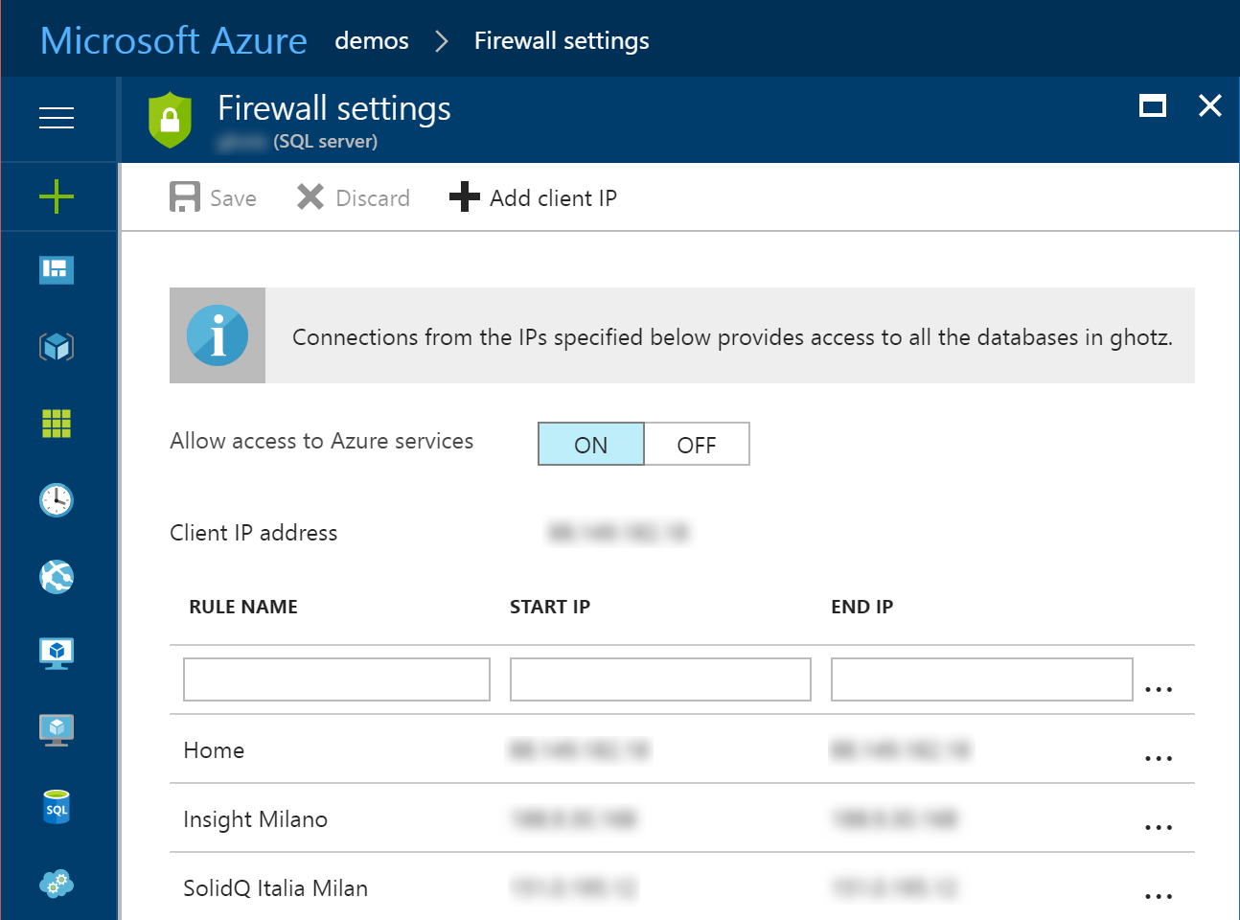
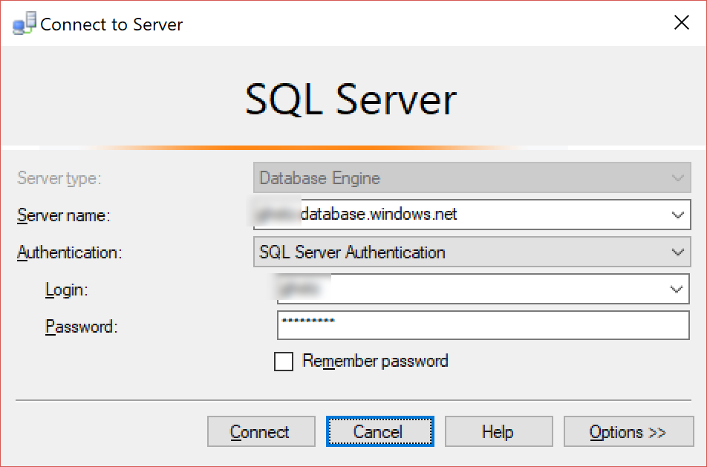
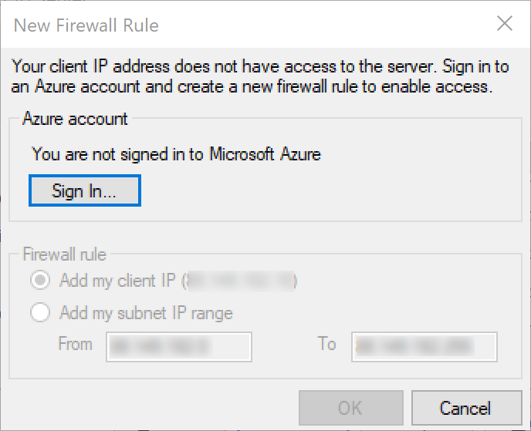
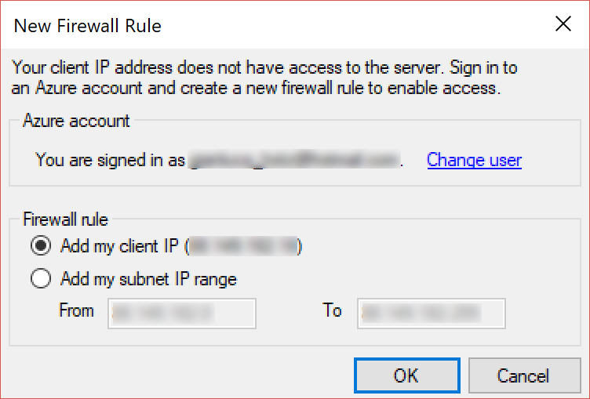
Azure Database Firewall
Accesso per servizi Azure
Indirizzi IP Specifici
Range di indirizzi IP
  No 0.0.0.0-255.255.255.255 ☺
Interfaccia SSMS
Comandi T-SQL
PowerShell, REST API
Notes:
https://docs.microsoft.com/en-us/azure/sql-database/sql-database-firewall-configure
https://docs.microsoft.com/en-us/azure/sql-database/sql-database-control-access#firewall-and-firewall-rules

Slide 11
Autenticazione
Due livelli: Server login e Database User
Nativa SQL Server
Integrata con Active Directory
  Utilizza protocollo Kerberos
  Supporto Azure Active Directory
  Supporto Active Directory Universal Authentication
    Multi-factor Authentication (es. via telefono)
    Supportata solo con SSMS a partire dalla versione 17
Best Practice
  Autenticazione integrata
  Database Containment (autenticazione a livello database)
Notes:
https://docs.microsoft.com/en-us/azure/sql-database/sql-database-control-access#authentication
https://docs.microsoft.com/en-us/sql/relational-databases/security/contained-database-users-making-your-database-portable
Use AD authentication:
• Reduces the proliferation of user identities across database servers.
• Allows password rotation in a single place.
• Enables managing database permissions using external (Azure AD) groups.
• Enables integrated Windows authentication and other forms of authentication supported by Azure Active Directory.
• Azure AD authentication uses contained database users to authenticate identities at the database level (considered more secure).
• Supports token-based authentication for applications connecting to SQL Database.
• Supports Active Directory Federation Services (ADFS) or native user/password authentication for a local Azure Active Directory without domain synchronization.

Slide 12
Autorizzazioni
Permessi granulari
  GRANT cosa può fare ON su che oggetto TO chi
  Ereditarietà gerarchia di oggetti
  Assegnazione (GRANT), negazione (DENY), revocare (REVOKE)
  Row Level Security
Ruoli a livello di server e database
  Es. sysadmin, dbcreator, db_datareader, db_datawriter
  Specifici per alcune funzionalità (database msdb)
Principio guida: minor privilegio!
  Possibile elevare temporaneamente
    Impersonation
    Stored Procedure (in generale moduli T-SQL firmati)
Notes:
https://docs.microsoft.com/en-us/azure/sql-database/sql-database-control-access#authorization
https://docs.microsoft.com/en-us/dotnet/framework/data/adonet/sql/signing-stored-procedures-in-sql-server

Slide 13
Protezione
SQL Server & GDPR

Slide 14
Attore principale: crittografia, ma dove?
Dati in transito
  Autenticazione (sempre crittografata)
  Spostamento dati
    invio richieste (parametri)
    caricamento in memoria
    invio risposte (record set)
Dati a riposo
  File database (dati e log transazioni)
  File di trace/audit

Slide 15
Crittografia comunicazioni
On-premise
  Installazione Certificato (server e client)
  Possibile forzare utilizzo (server e client)
  Autenticazione sempre crittografata (nel caso «self-signed»)
Azure SQL Database (e SQL Data Warehouse)
  Connessione crittografata sempre necessaria!
  Es. connessione ADO.NET Encrypt=True;TrustServerCertificate=False
Transport Layer Security (TLS) 1.2
  Windows Server 2008 R2
  SQL Server 2008 SP4 (hotfix)
Notes:
https://docs.microsoft.com/en-us/sql/database-engine/configure-windows/enable-encrypted-connections-to-the-database-engine
https://support.microsoft.com/en-us/help/3135244/tls-1.2-support-for-microsoft-sql-server
Why is this important for the GDPR?
GDPR talks about integrating the “necessary safeguards into the processing” (GDPR Article 25(1), “Data protection by design and by default”), and accounting for risks presented by processing, “in particular from accidental or unlawful destruction, loss, alteration, unauthorized disclosure of, or access to personal data transmitted, stored or otherwise processed” (GDPR Article 32(2), “Security of processing”). Protecting data during transmission is explicitly called out in this context—to avoid possible leakage and minimize these risks.

Slide 16
Crittografia dati prima di SQL Server 2016
Transparent Data Encryption (TDE)
  File dati, log e backup
  Dati decifrati quando caricati in memoria*
  Completamente trasparente per le applicazioni
Cell-Level Encryption (CLE)
  Granularità a livello di Colonna
  Protezione parziale in memoria
  Non trasparente per le applicazioni
Entrambi meccanismi crittografici Server-Side
  Protezione dati a riposo (es. furto dischi o backup)
  Utenti con privilegi elevati possono ottenere accesso ai dati
Notes:
Both server-side, protects from stolen files but not attack in memory
AES-NI support is new in SQL Server 2016, before an alternative could be to use Bitlocker with AES-NI support
Partial protection in memory by CLE is provided because ENCRYPTBYKEY/DECRYPTBYKEY still needs to be used
High privilege users can be local admin or admin at the hosting site
https://blogs.msdn.microsoft.com/sqlsecurity/2016/10/05/feature-spotlight-transparent-data-encryption-tde
https://docs.microsoft.com/en-us/sql/relational-databases/security/encryption/encrypt-a-column-of-data
Why is this important for the GDPR? (TDE)
This relates to the GDPR obligation to take into account “risks that are presented by processing, in particular from accidental or unlawful destruction, loss, alteration, [or] unauthorized disclosure of” that data. In this case, the protection is at the level of the physical device—and prevents the risk of compromising the storage itself, for example via copying the physical data out to another server.
GDPR Article 32(2)—“Security of processing.”

Slide 17
Always Encrypted
SQL Server & GDPR

Slide 18
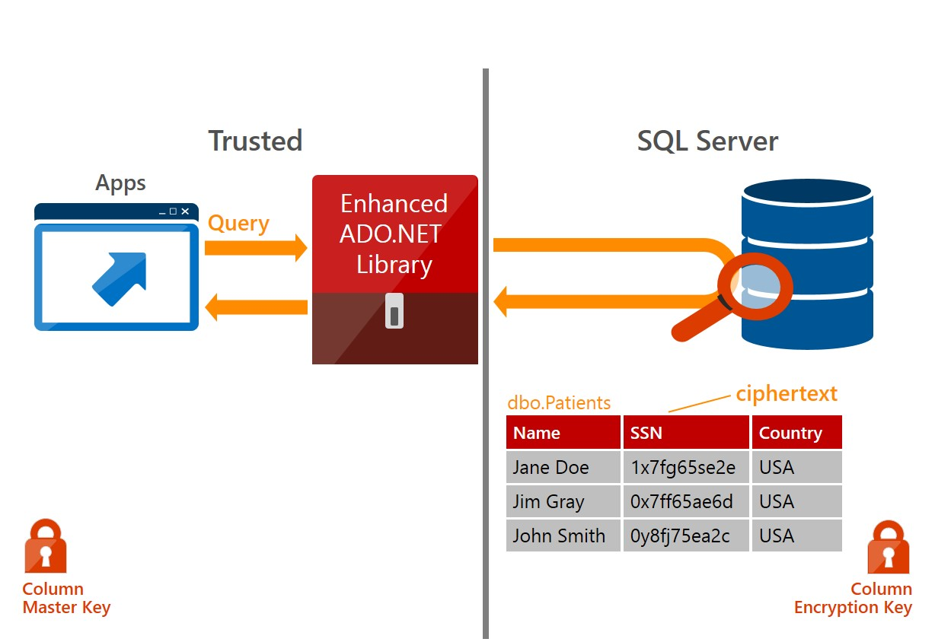
Panoramica Always Encrypted
Notes:
Why is this important for the GDPR?
The use of this powerful encryption feature which better ensures that highly sensitive data is encrypted on the server side, even in-memory, can significantly help in meeting the GDPR requirements around “Security of processing.” This particularly applies to the requirement to “implement appropriate technical and organizational measures to ensure a level of security appropriate to the risk” including, as appropriate, “the pseudonymization and encryption of personal data”.
GDPR Article 32(2) – “Security of processing.”

Slide 19
Always Encrypted Keys
Column Encryption Key (CEK)
  Usate per crittografare i dati
  Conservate solo in forma crittografata sul server
  Legate a specifiche colonne
Column Master Key (CMK)
  Usate per crittografare le CEK
  Conservate in un «key store» esterno
    Windows Certificate Store, Azure Key Vault, HSM, Custom
  Deve essere disponibile alle applicazioni
Notes:
Custom example: can store the key in Amazon and build a custom store provider

Slide 20
Crittografia dei dati
Deterministica
  Permette operazioni di uguaglianza/raggruppamento/join
  Permette indicizzazione
  Più debole es. domini con pochi valori come sesso o «flag»
  Richiede collation _BIN2
Casuale
  Nessuna operazione permessa
  Indicizzazione non permessa
  Più robusta

Slide 21
Configurazione Always Encrypted
SQL Server Management Studio
  Wizard end-to-end
  Interfacce specifiche
  Scenario rotazione chiavi supportato
Solo parte della configurazione disponibile in T-SQL
  CMK de crittografata disponibile solo esternamente!
PowerShell

Slide 22
Configurazione Client Always Encrypted
Stringa di connessione
  Column Encryption Setting=Enabled
Esecuzione di comandi
  SqlCommand.ColumnEncryptionSetting*
    Disabled, Enabled, ResultSetOnly, UseConnectionSetting
Notes:
ResultsSetOnly decrypts only the result set without calling the stored procedure to get encrypted keys metadata (useful when you’re using parameters on columns that are not encrypted)

Slide 23
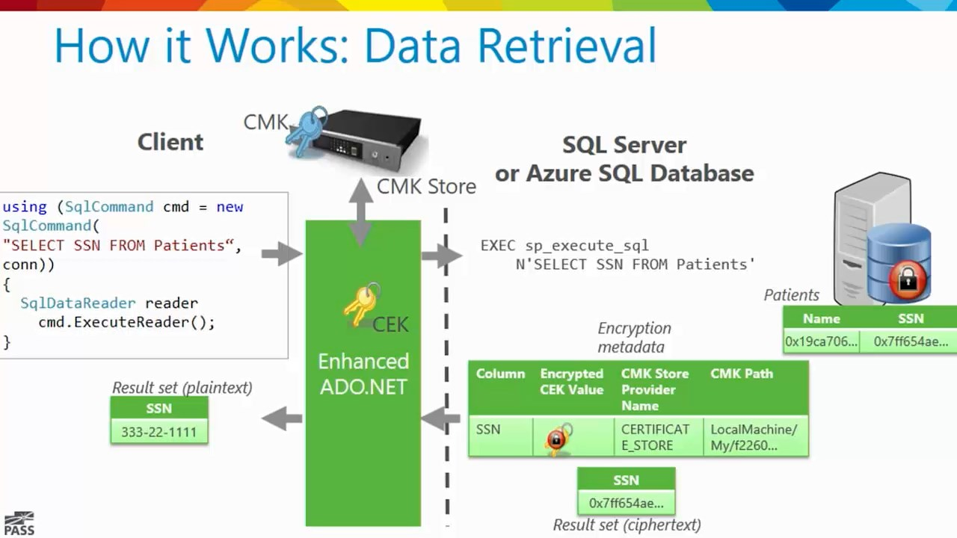
Recupero dati con Always Encrypted

Slide 24
Always Encrypted e parametri
Comandi parametrizzati necessitano «round-trip»
  Chiamata a sys.sp_describe_parameter_encryption
  Ritorna metadati chiavi e chiavi crittografate
  .NET Framework 4.6.2 mitiga «round-tripping» implementando cache a livello di applicazione
In generale
  No query «ad-hoc» con predicati «letterali» (valori costanti)
  No operazioni tra dati crittografati e dati in chiaro («cyphertexts» e «plaintexts»)
  Nulla che richieda di de-crittografare i dati lato server

Slide 25
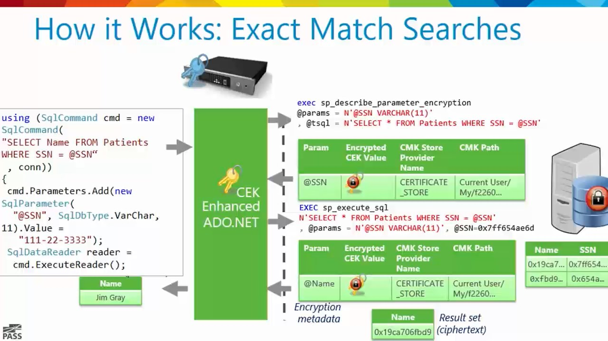
Corrispondenze esatte con Always Encrypted

Slide 26

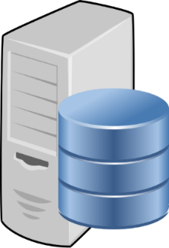

Flusso corrispondenze esatte AE
  I dati sensibili crittografati con le relative chiavi crittografiche non sono mai disponibili in chiaro sul server!
trust boundary
SQL Server or Azure SQL Database
Client
"SELECT Name FROM Customers WHERE SSN = @SSN",
"111-22-3333"
ADO .NET
"SELECT Name FROM Customers WHERE SSN = @SSN",
0x7ff654ae6d
ciphertext
Result Set
Result Set
Name
Wayne Jefferson
Name
0x19ca706fbd9a
dbo.Customers
Name | SSN | Country
0x19ca706fbd9a | 0x7ff654ae6d | USA
ciphertext
Notes:
https://msdn.microsoft.com/en-us/library/mt163865.aspx
https://channel9.msdn.com/events/DataDriven/SQLServer2016/AlwaysEncrypted
https://channel9.msdn.com/events/Ignite/2016/BRK3151

Slide 27
DEMO

Slide 28
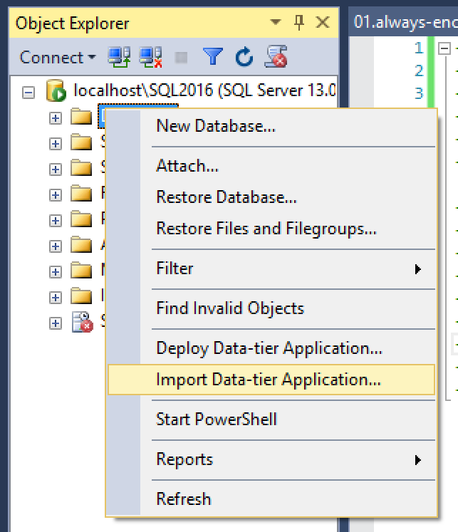
Import: Menu

Slide 29
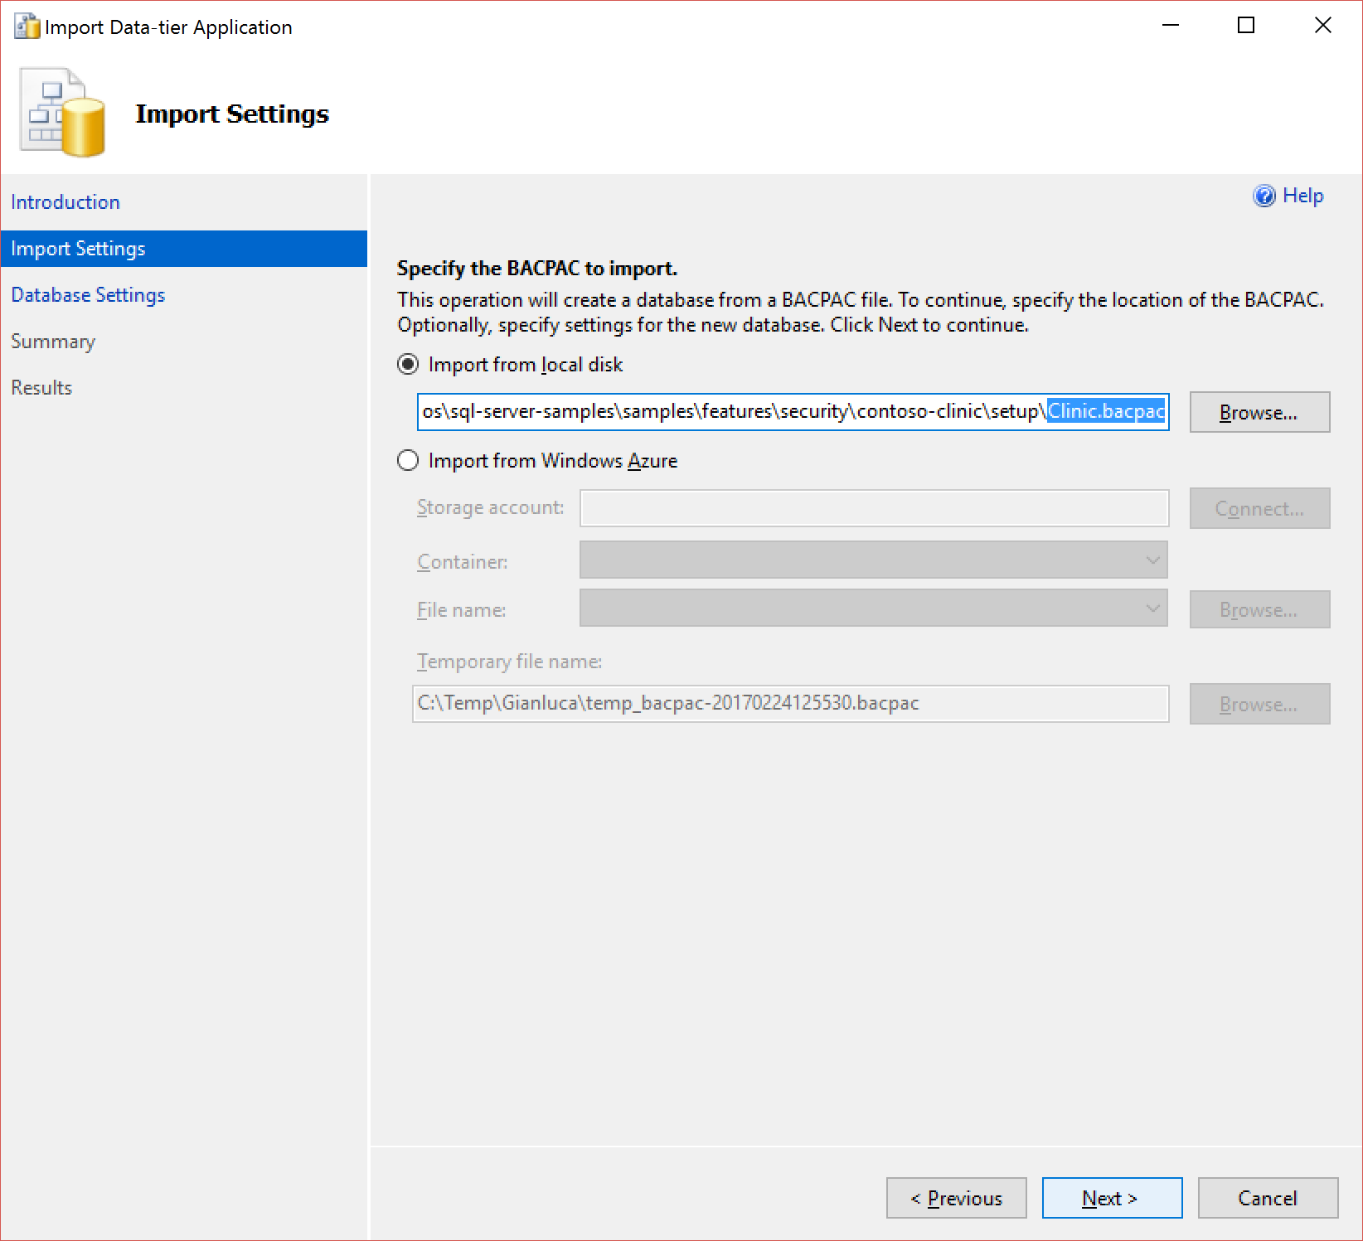
Import: Settings

Slide 30
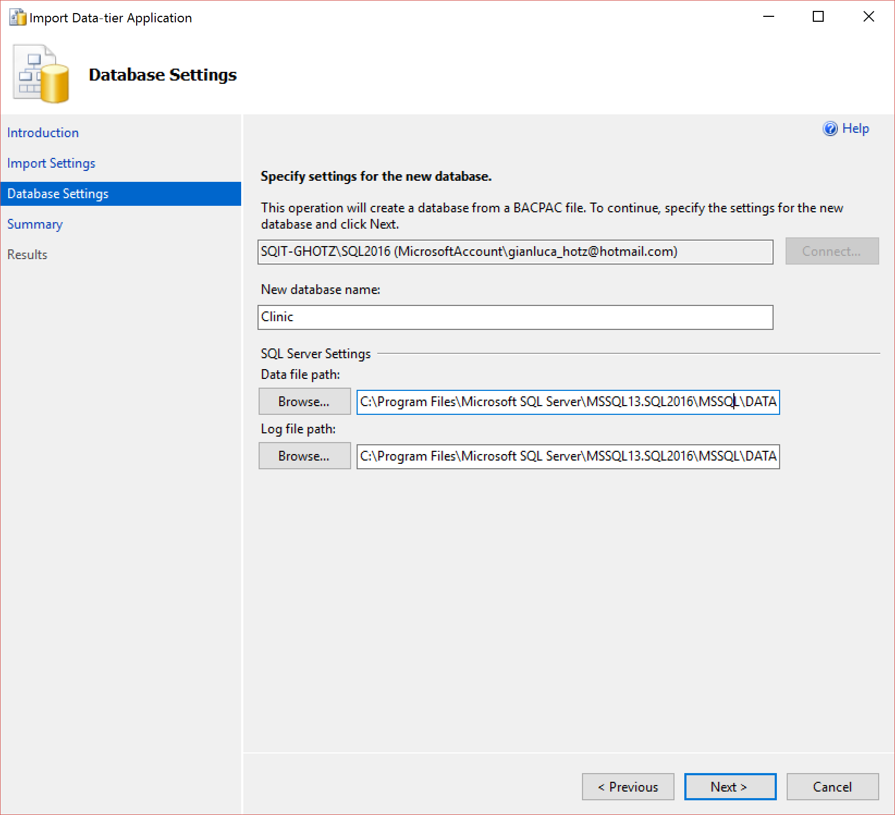
Import: Database Settings

Slide 31
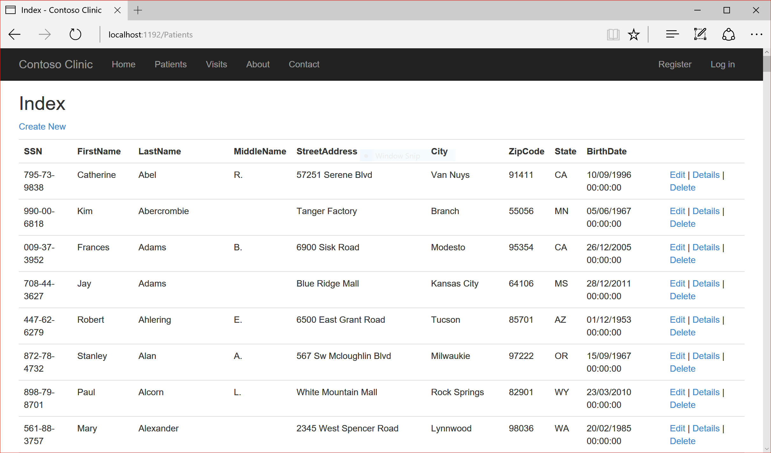
Application (unencrypted data)

Slide 32
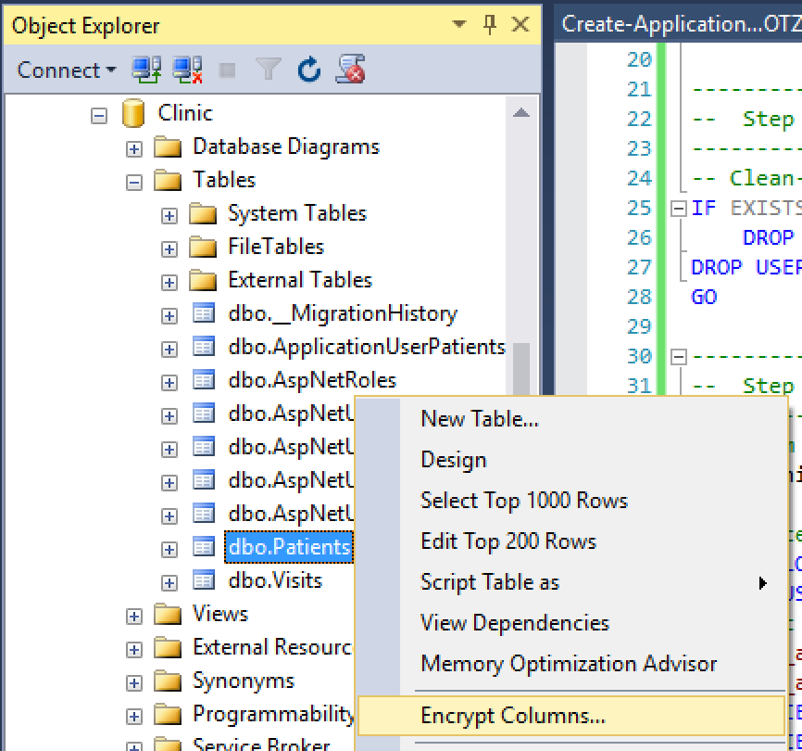
Encrypt columns: menu

Slide 33
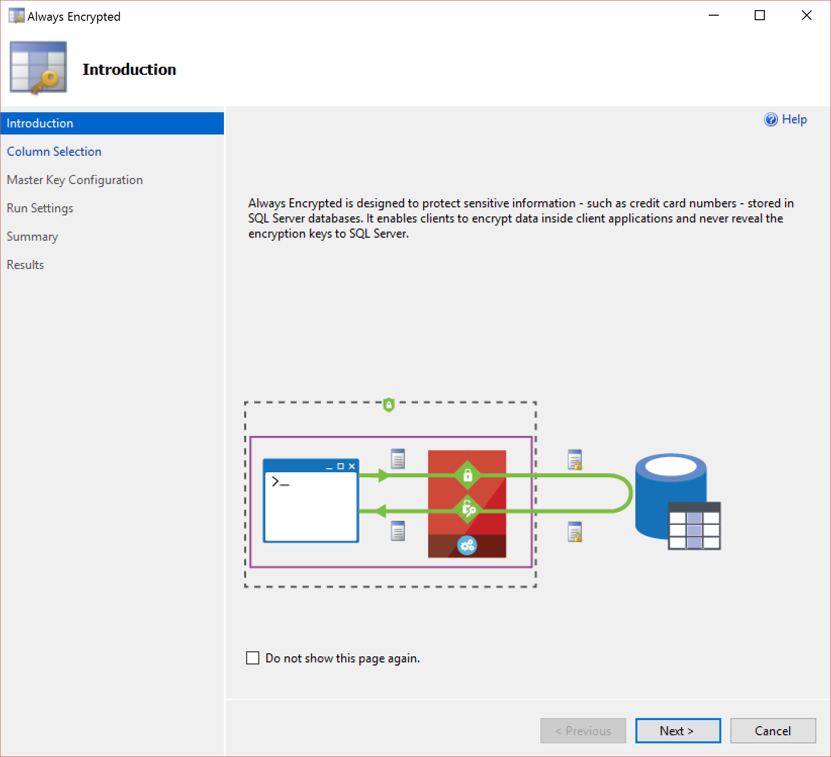
Encrypt columns: introduction

Slide 34
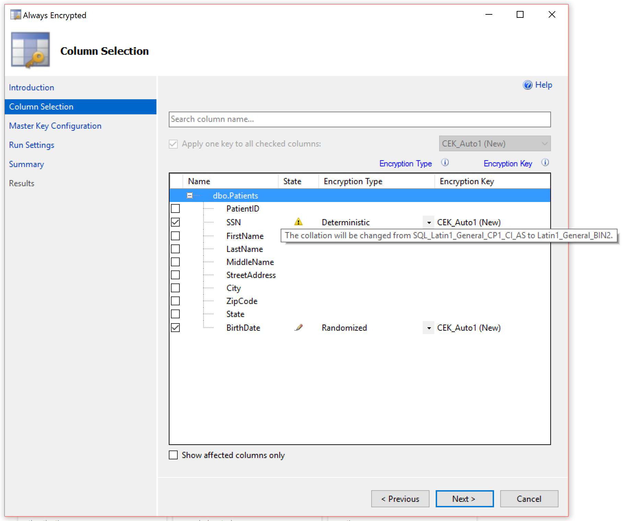
Encrypt columns: column selection

Slide 35
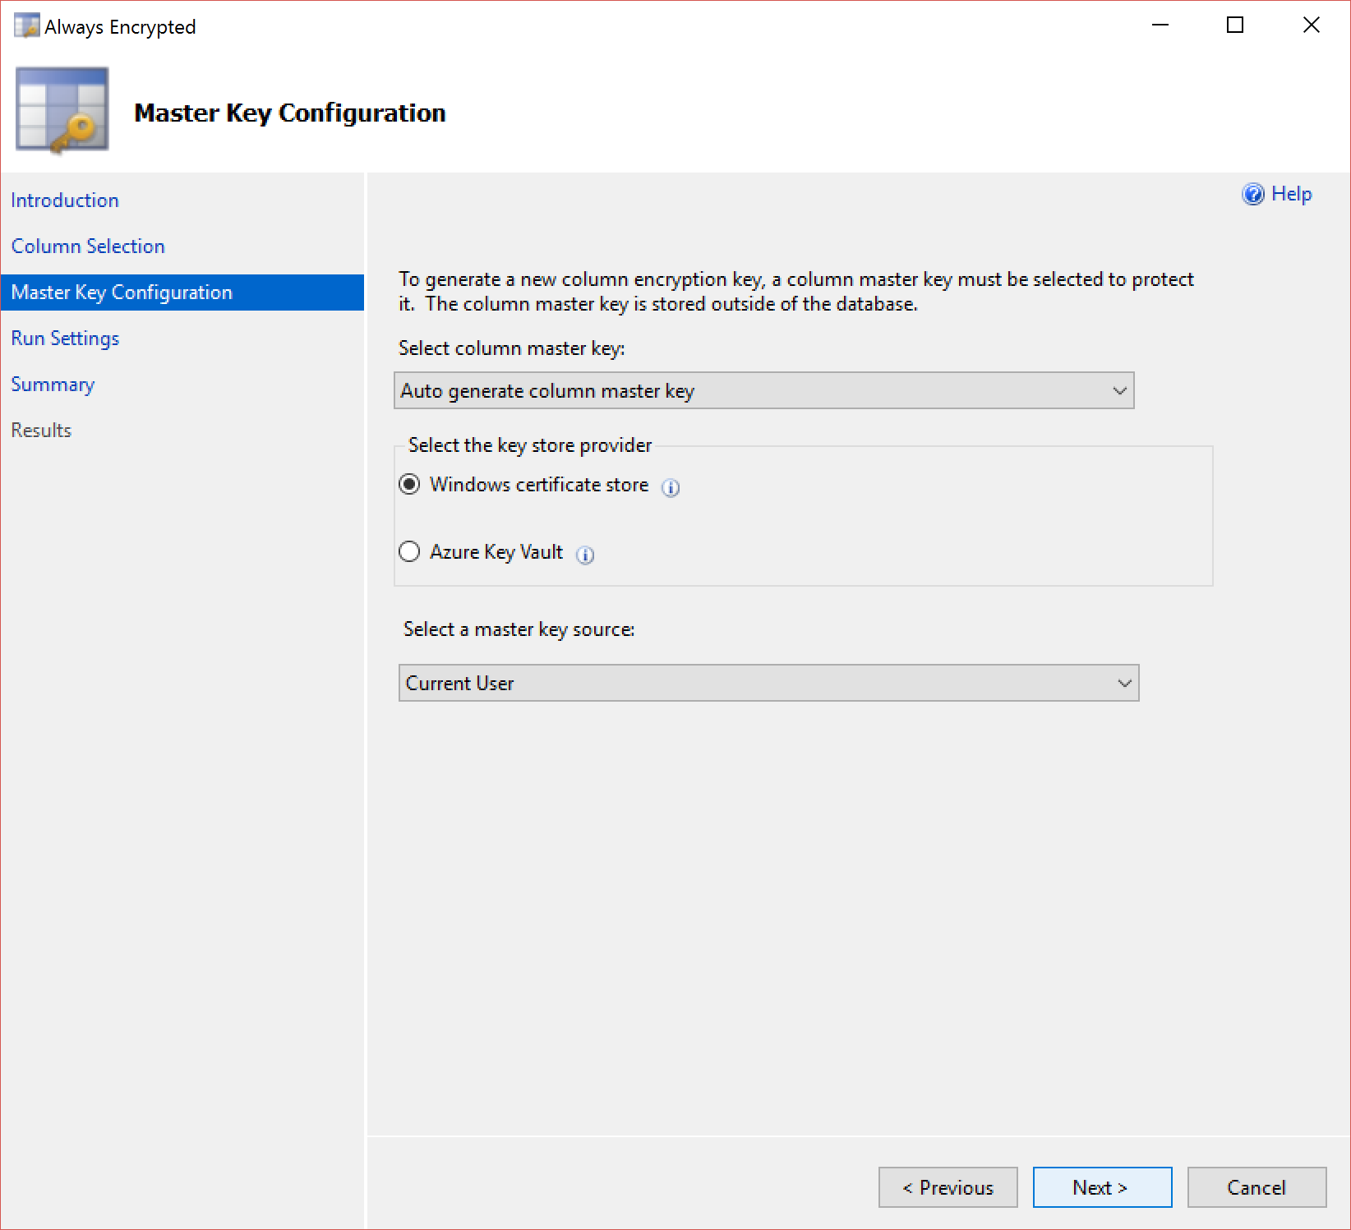
Encrypt columns: Master Key config

Slide 36
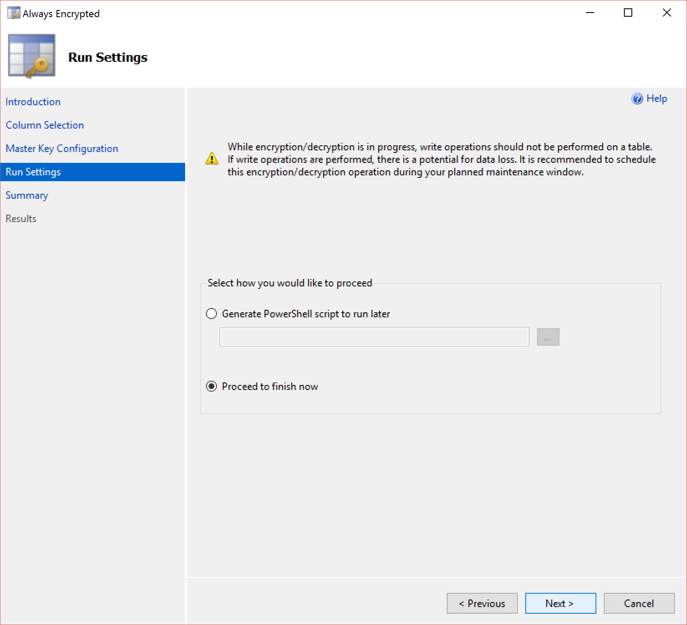
Encrypt columns: run settings

Slide 37
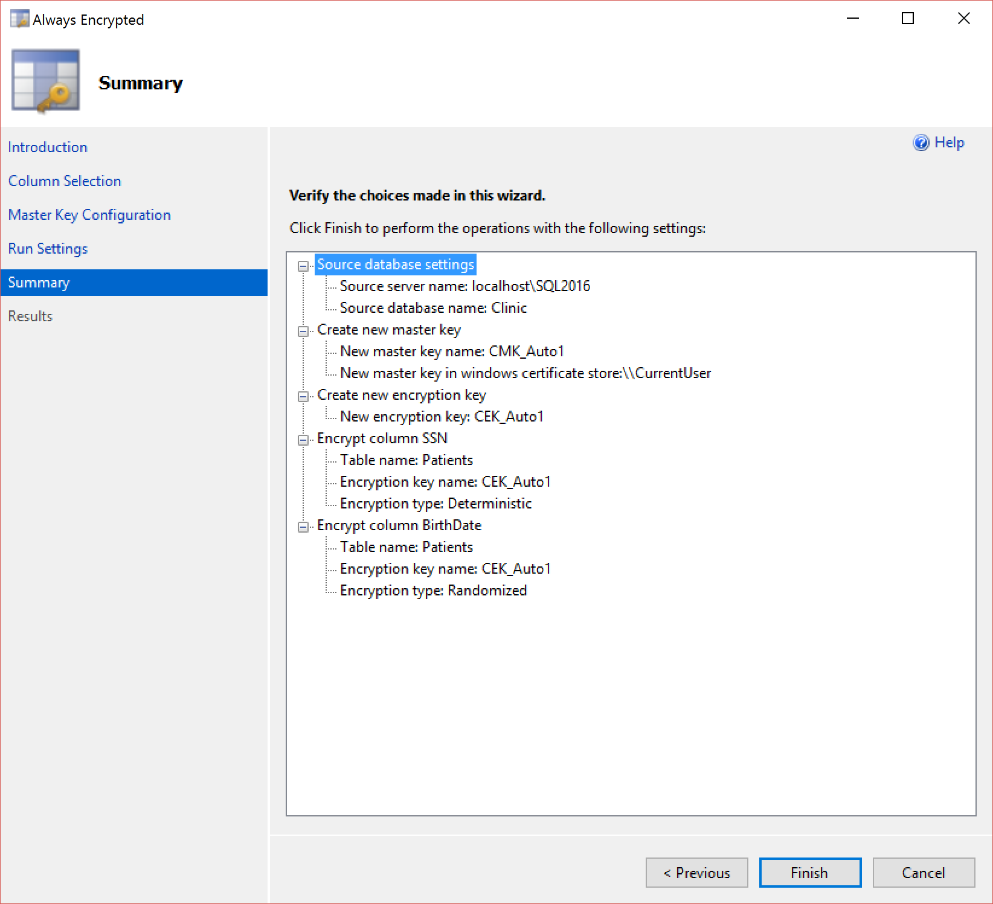
Encrypt columns: summary

Slide 38
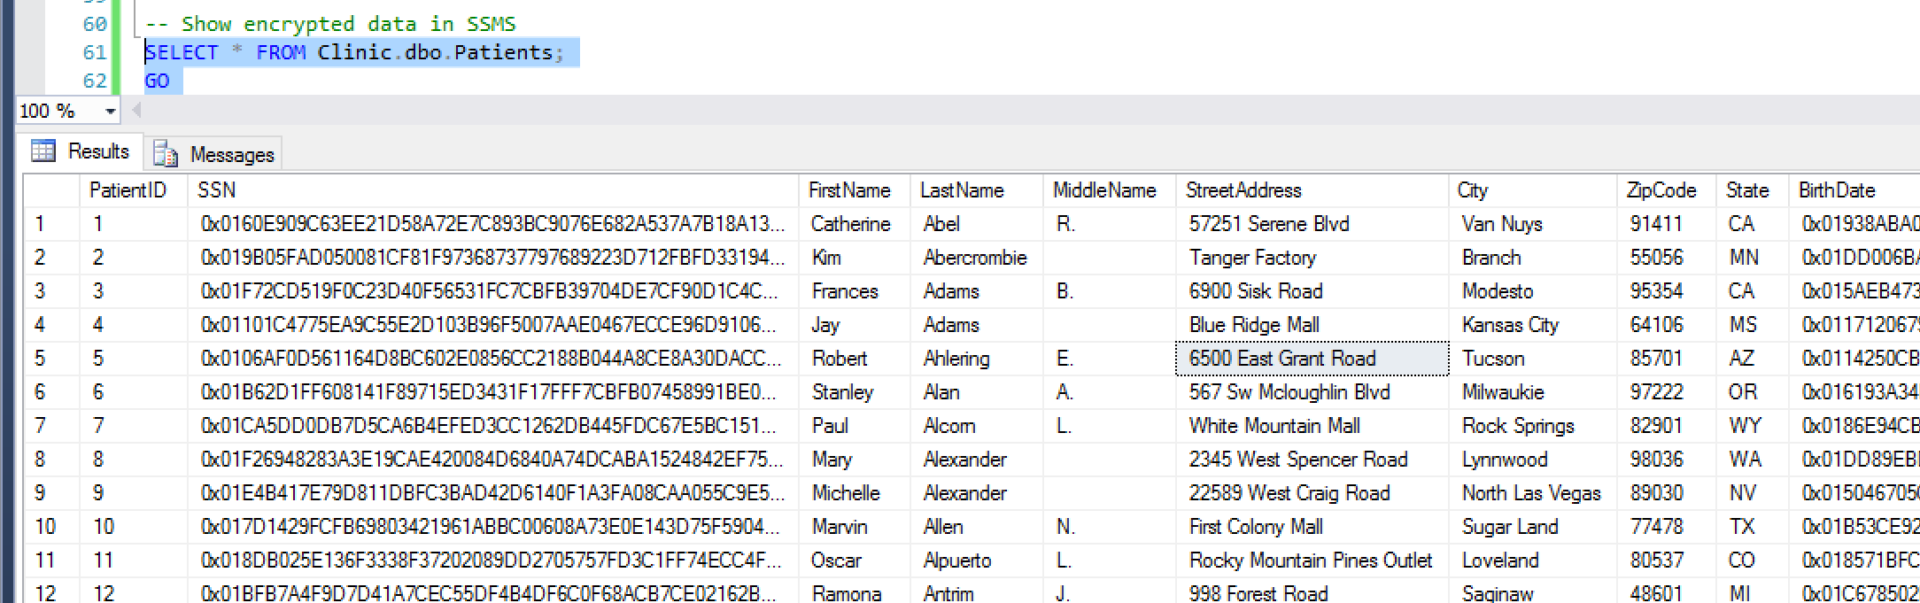
Encrypted data in SSMS

Slide 39
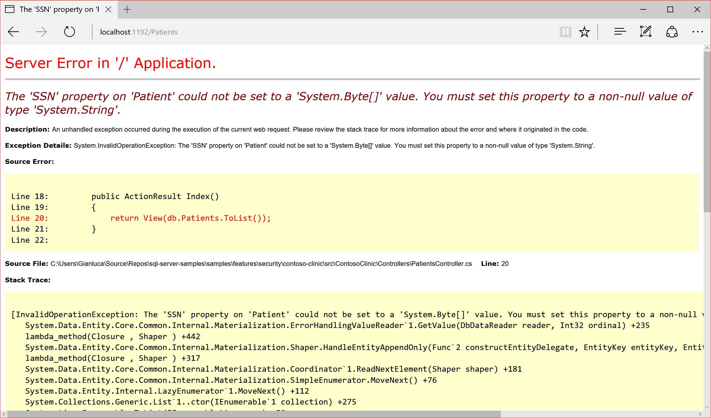
Application: encrypted data type error

Slide 40
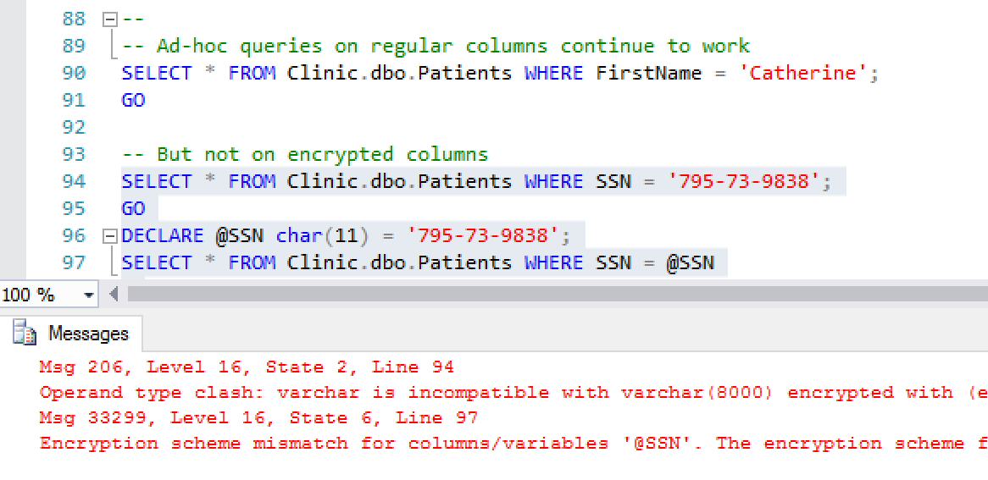
Encrypted data ad-hoc/params queries

Slide 41
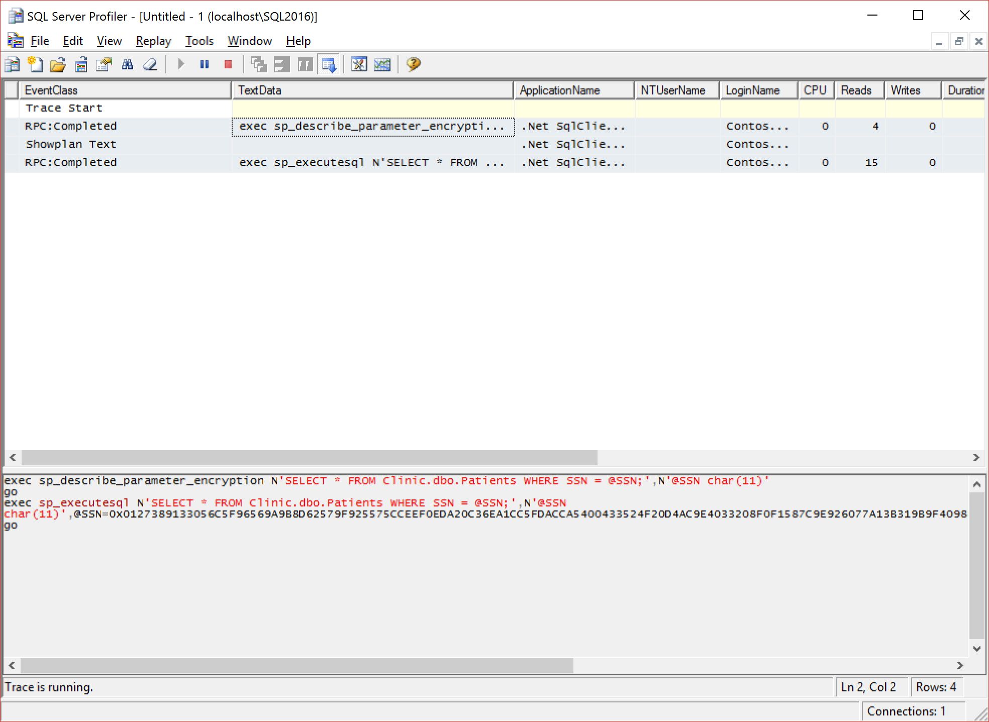
Parametrized Commands Round-trip

Slide 42
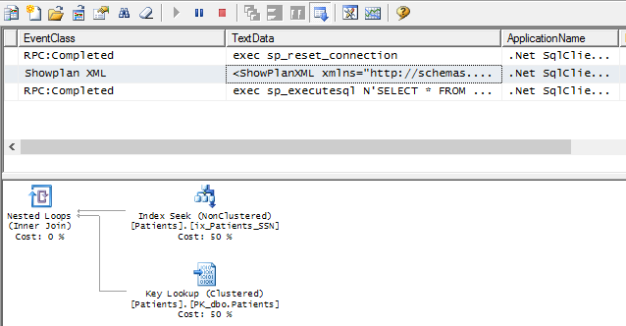
Parametrized Commands Round-trip

Slide 43
Benefici Always Encrypted
Protegge in caso di violazione dei dati
  Database Engine ma ricordatevi…
  … del «middle-tier»!
Permette distribuzione/gestione
  attraverso confini geo-politici
GDPR
  Art. 9 «Processing of special categories of personal data»
  Art. 32 «Security of processing»
Notes:
Art. 9 Processing of these special categories is forbidden except in the specified cases and only “by or under the responsibility of a professional subject to the obligation of professional secrecy under Union or Member State law”; Always Encrypted helps to the extent that no highly privileged user (i.e. sysadmin) can gain access to these special categories of data
Art. 32 Use of Always Encrypted ensures that highly sensitive data is encrypted on the server side, even in-memory; this can significantly help in meeting the GDPR requirements around “Security of processing.” In particular, the requirement to “implement appropriate technical and organizational measures to ensure a level of security appropriate to the risk” including, as appropriate, “the pseudonymization and encryption of personal data”.

Slide 44
Row Level Security
SQL Server & GDPR

Slide 45


Row-Level Security
Due
L’utente (es. l’infermiera) seleziona dalla tabella dei pazienti solo quelli che può vedere.
Tre
La «Security Policy» riscrive trasparentemente la query applicando il predicato.
Uno
Gestore delle policy crea un predicato in T-SQL per filtrare i dati in base all’identificativo utente e crea «security policy» che vincola tale predicato alla tabella dei pazienti.
Nurse
Database
Policy Manager
Security
Policy
Filter
Predicate:
INNER
JOIN…
Application
Patients
CREATE FUNCTION dbo.fn_securitypredicate(@wing int)
RETURNS TABLE WITH SCHEMABINDING AS
return SELECT 1 as [fn_securitypredicate_result] FROM
StaffDuties d INNER JOIN Employees e
ON (d.EmpId = e.EmpId)
WHERE e.UserSID = SUSER_SID() AND @wing = d.Wing;
CREATE SECURITY POLICY dbo.SecPol
ADD FILTER PREDICATE dbo.fn_securitypredicate(Wing) ON Patients
WITH (STATE = ON)
SELECT * FROM Patients
SEMIJOIN APPLY dbo.fn_securitypredicate(patients.Wing);
SELECT * FROM Patients
SELECT Patients.* FROM Patients,
StaffDuties d INNER JOIN Employees e ON (d.EmpId = e.EmpId)
WHERE e.UserSID = SUSER_SID() AND Patients.wing = d.Wing;
Notes:
https://msdn.microsoft.com/en-us/library/dn765131.aspx

Slide 46
Panoramica Row Level Security
Restringe l’accesso a un sottoinsieme di righe
Basata su predicati di sicurezza
  Definiti come «inline Table-Valued Functions»
  «Filter predicate» limita righe a operazioni in lettura
    SELECT, UPDATE e DELETE
  «Block predicate» bloccano operazioni di scrittura
    AFTER INSERT, AFTER/BEFORE UPDATE, BEFORE DELETE
«Security Policy»
  Applica i predicati di sicurezza alle tabelle
Notes:
Why is this important for the GDPR?
Users have access only to the data that is pertinent to them, thus reducing the risk of “unauthorized disclosure of, or access to personal data.”
GDPR Article 32(2)—“Security of processing.”

Slide 47
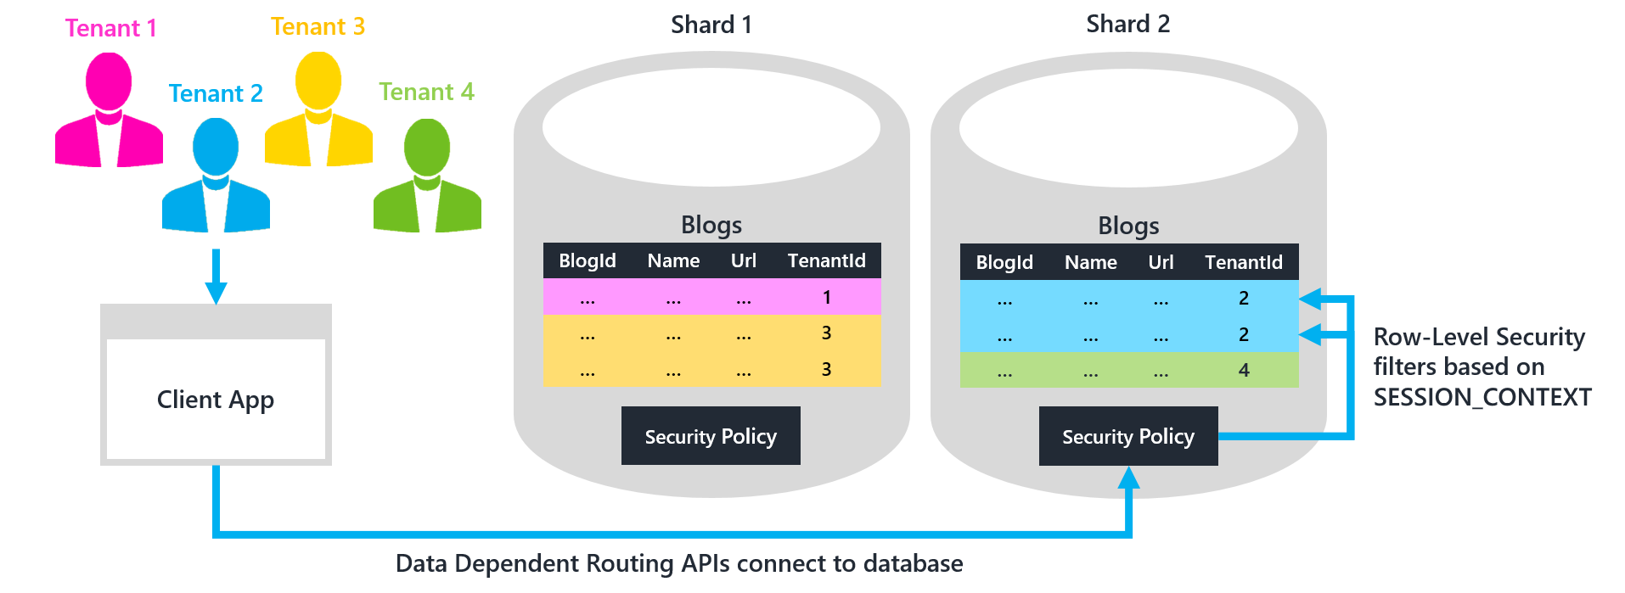
Row-Level Security & Multi Tenancy
Vincola accesso ai «tenant» quando «shard» condividono le stesse tabelle
Assumendo esistenza colonna che identifica il «tenant»
Image source: https://docs.microsoft.com/en-us/azure/sql-database/sql-database-elastic-tools-multi-tenant-row-level-security
Notes:
https://docs.microsoft.com/en-us/azure/sql-database/sql-database-elastic-tools-multi-tenant-row-level-security

Slide 48
DEMO

Slide 49
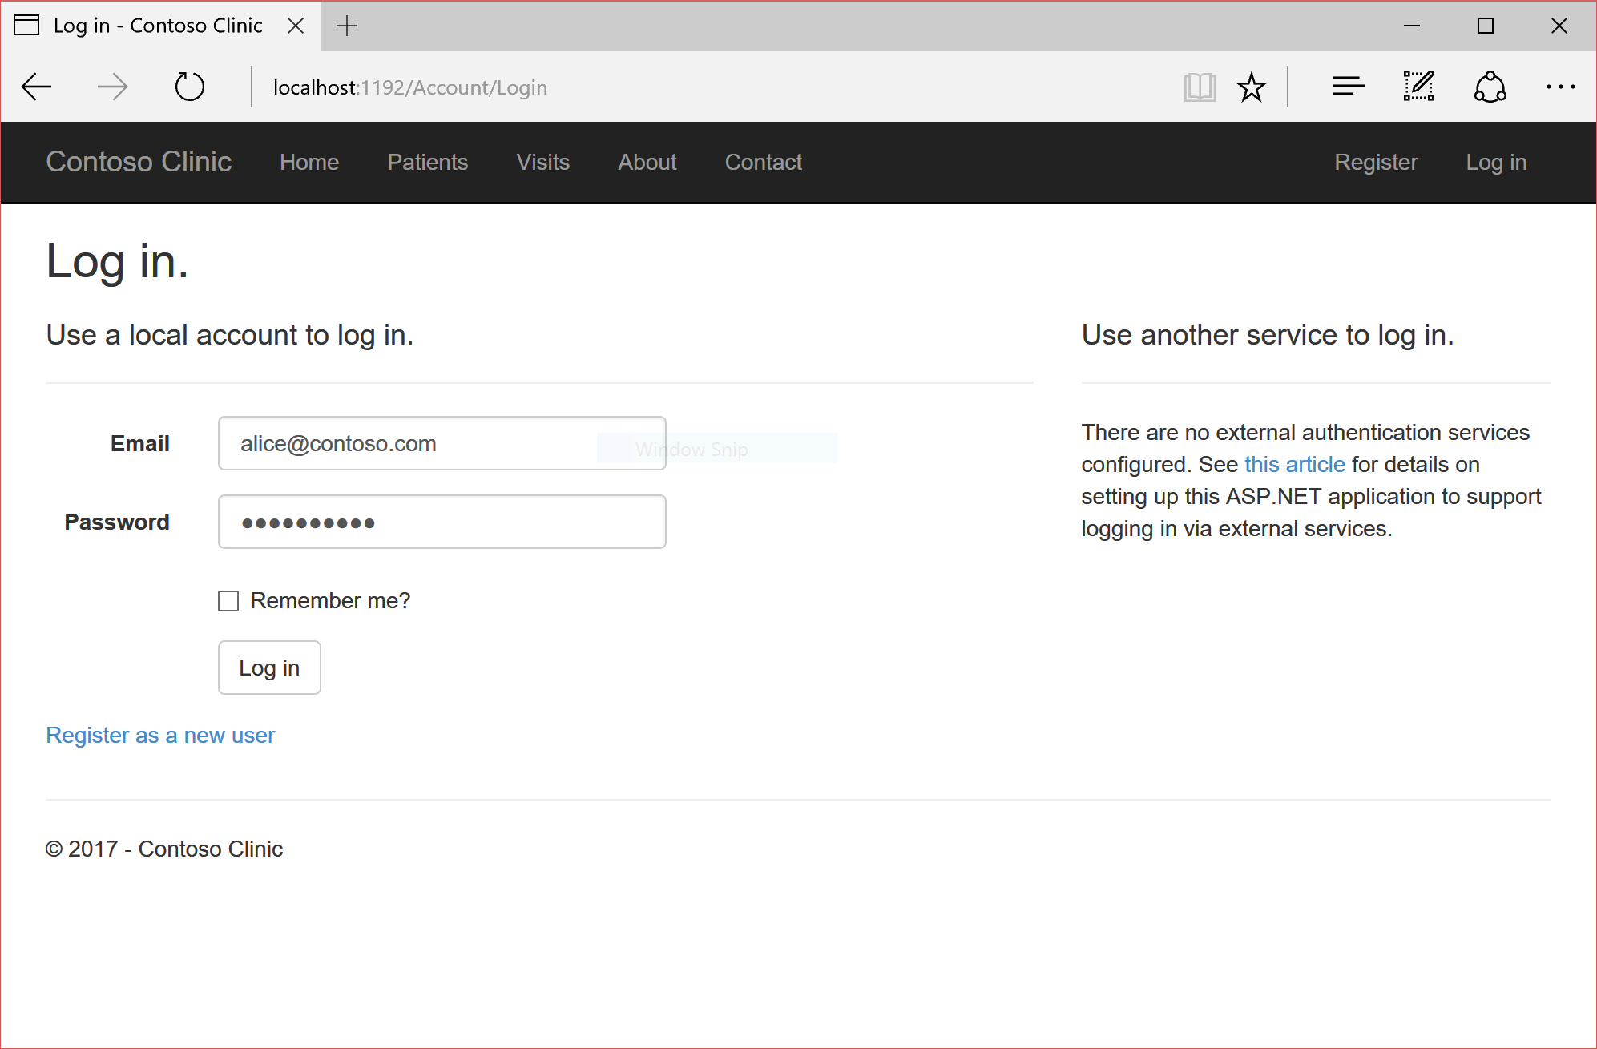
RLS: Alice login
Notes:
Remember the user ID from ASP.NET membership gets set via SESSION_CONTEXT()

Slide 50
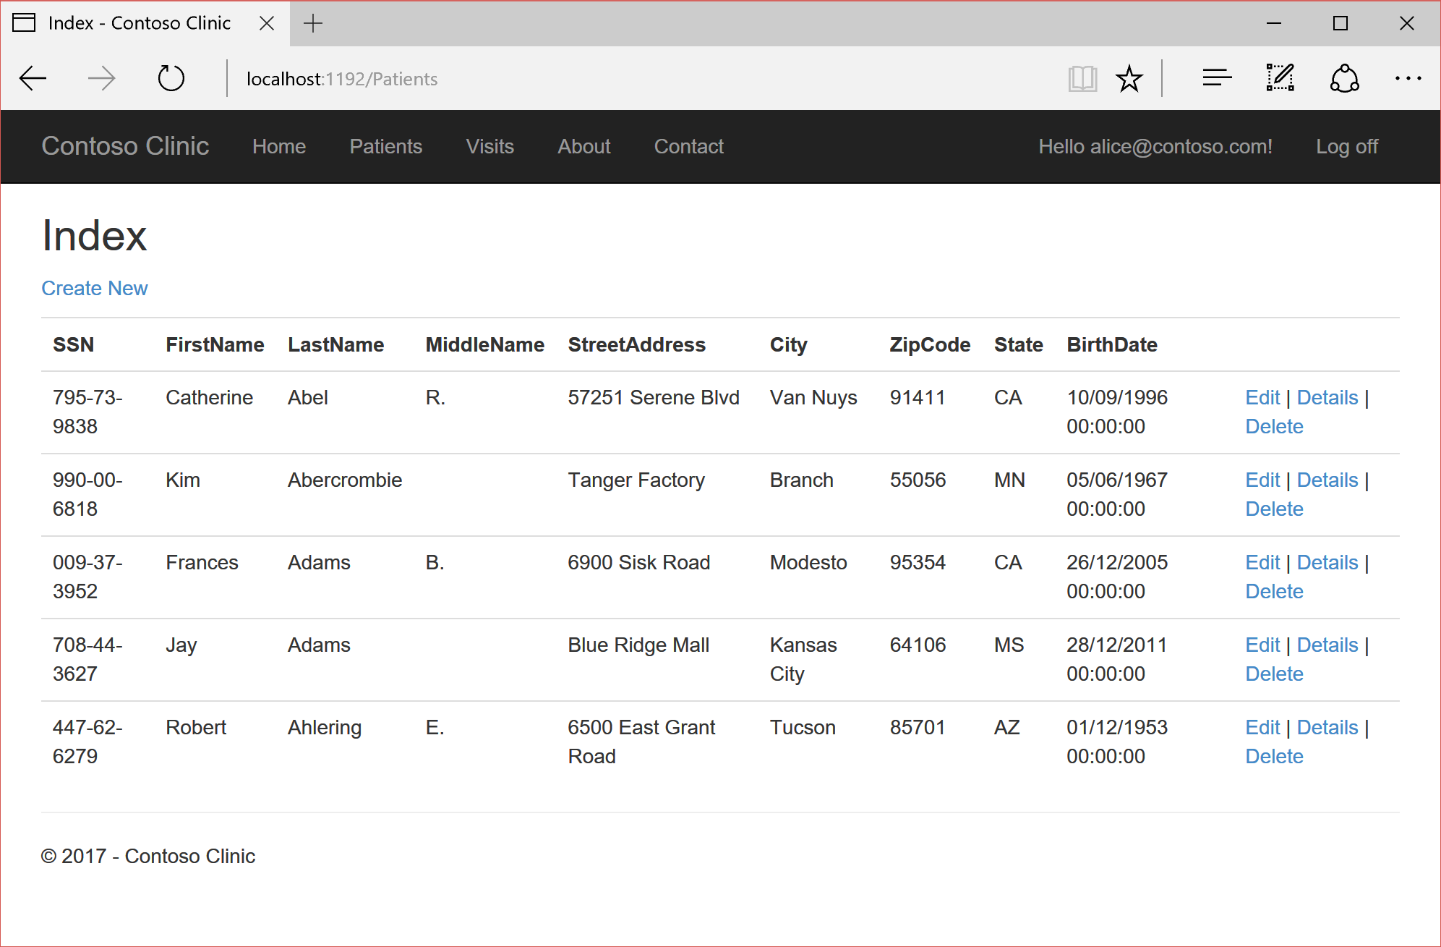
RLS: Alice sees her patients

Slide 51
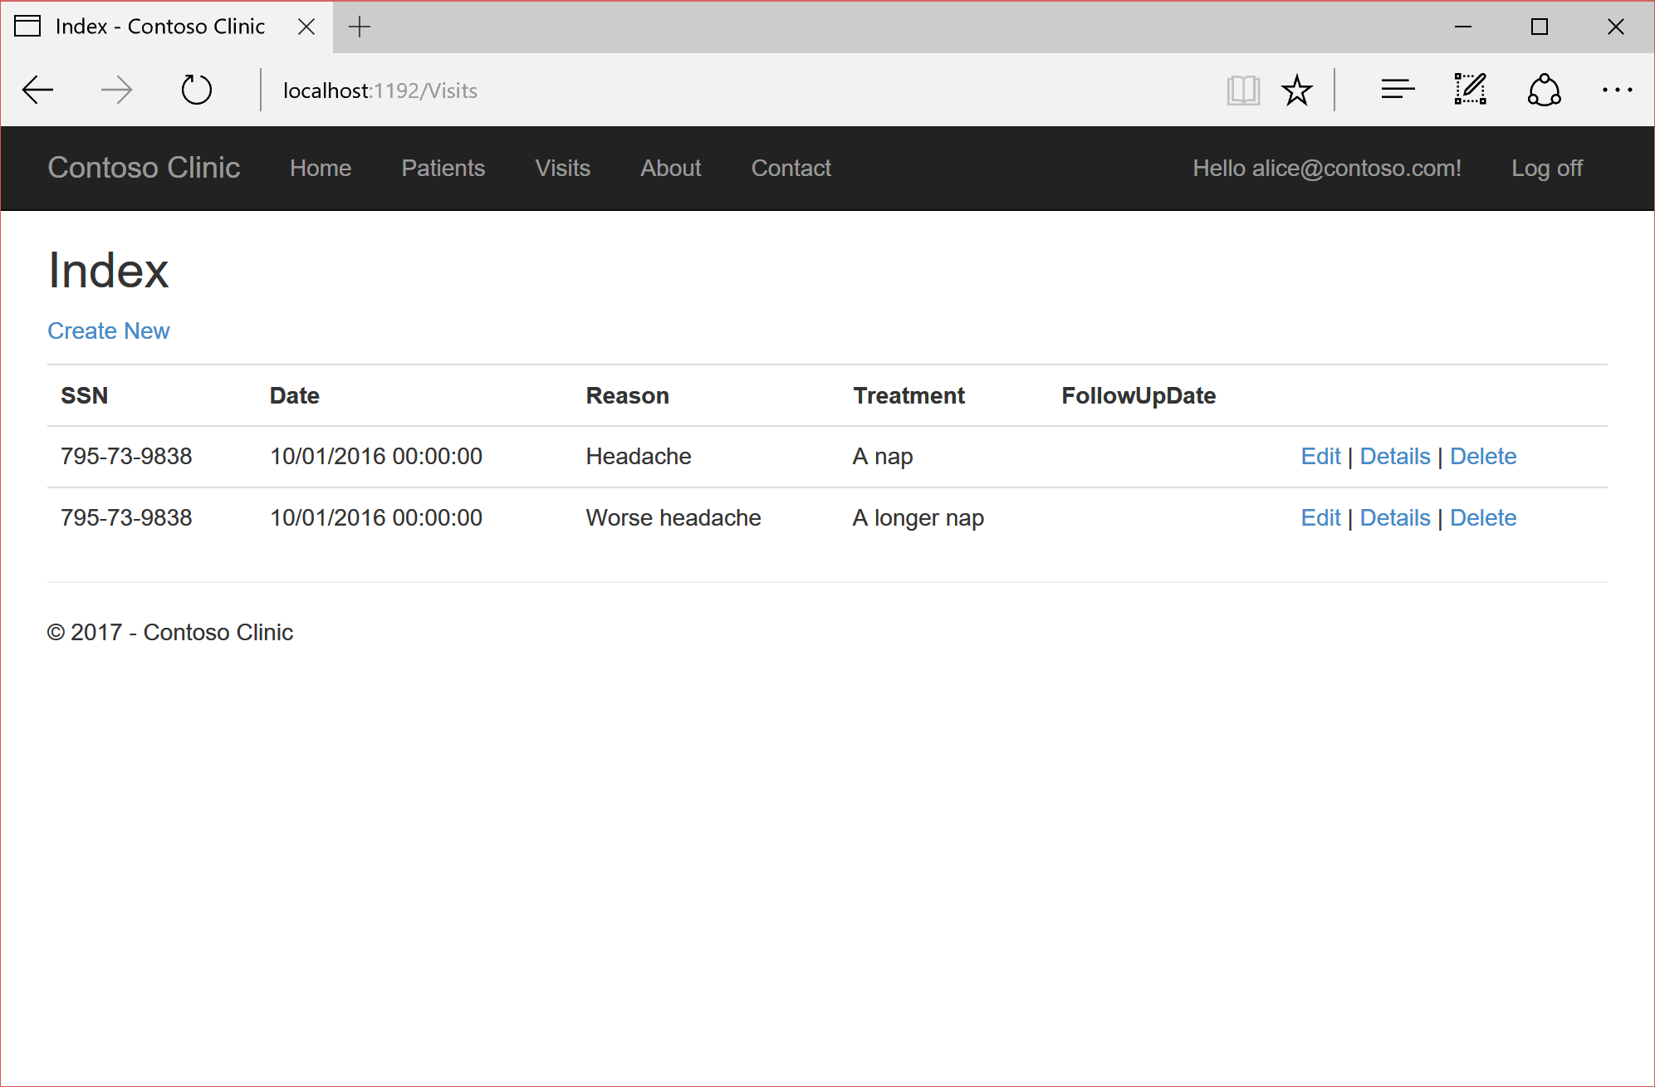
RLS: Alice sees her patients’ visits

Slide 52
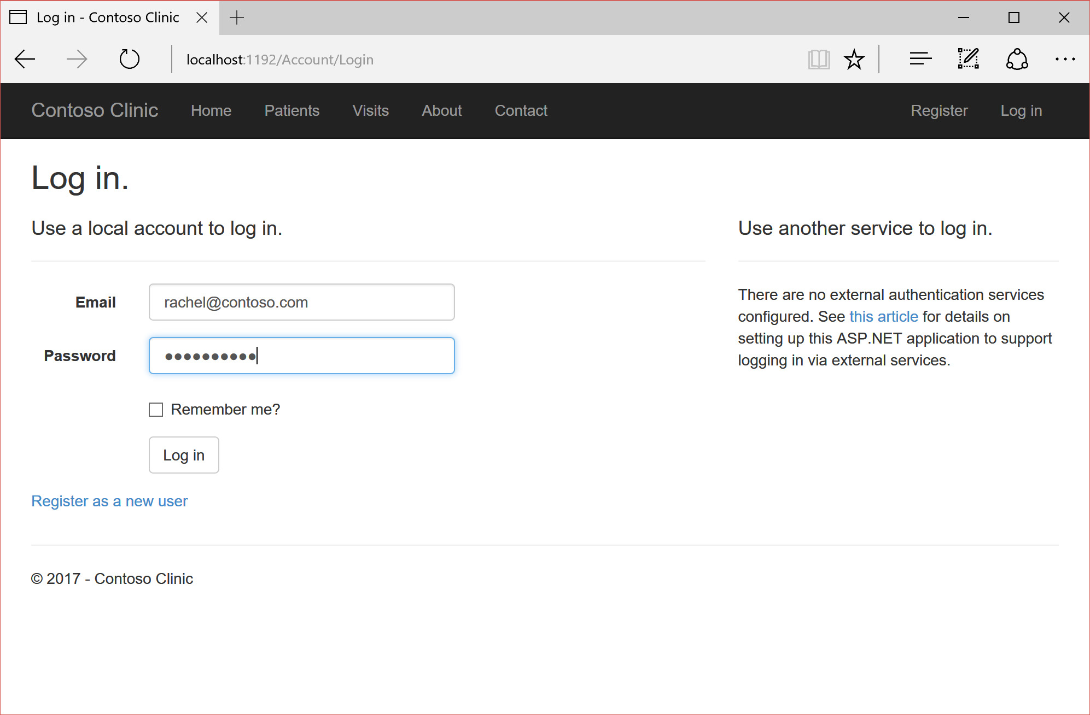
RLS: Rachel login

Slide 53
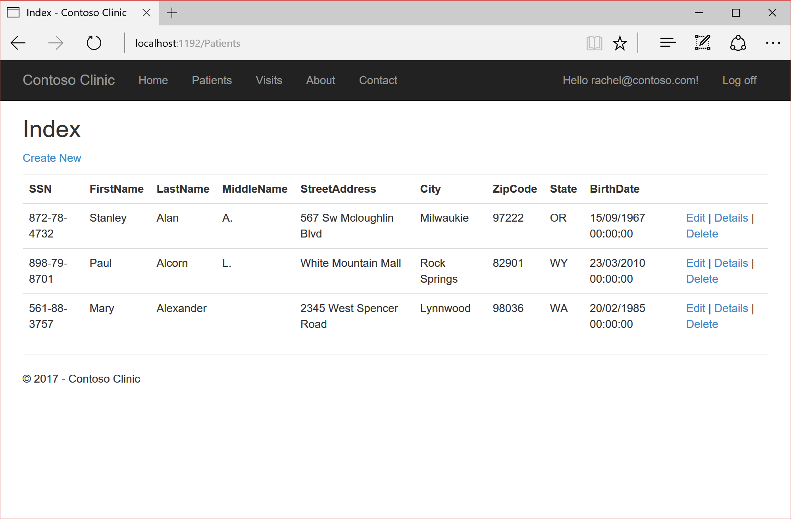
RLS: Rachel sees her patients

Slide 54
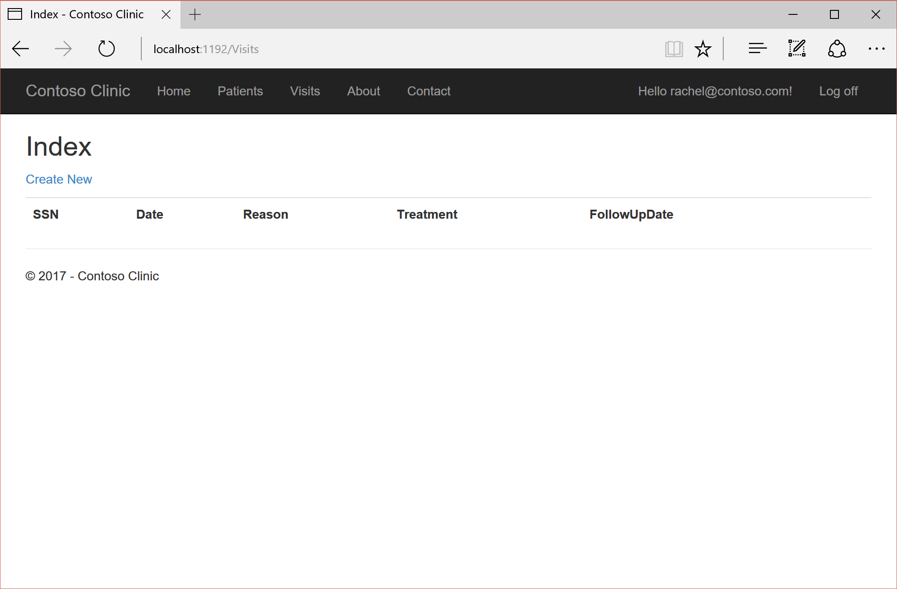
RLS: Rachel patients have no visits yet

Slide 55
Dynamic Data Masking
SQL Server & GDPR

Slide 56
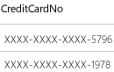
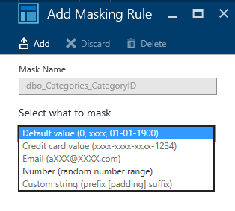
Dynamic Data Masking
Table.CreditCardNo
4465-6571-7868-5796
4468-7746-3848-1978
4484-5434-6858-6550
Mascheramento
  Real-time
  Diversi tipi di maschere
  Mascheratura parziale
Basato su regole/permessi
  A livello di colonna
  Permesso di «unmask»
Configurazione Azure nel portale
SQL Database
Notes:
https://msdn.microsoft.com/en-us/library/mt130841.aspx
https://docs.microsoft.com/en-us/azure/sql-database/sql-database-dynamic-data-masking-get-started
Why is this important for the GDPR?
The GDPR calls for implementing “appropriate technical and organizational measures, such as pseudonymization, which are designed to implement data-protection principles, such as data minimization, in an effective manner…”
GDPR Article 25(1)— “Data protection by design and by default.”

Slide 57
DEMO

Slide 58
DDM: Alice login

Slide 59
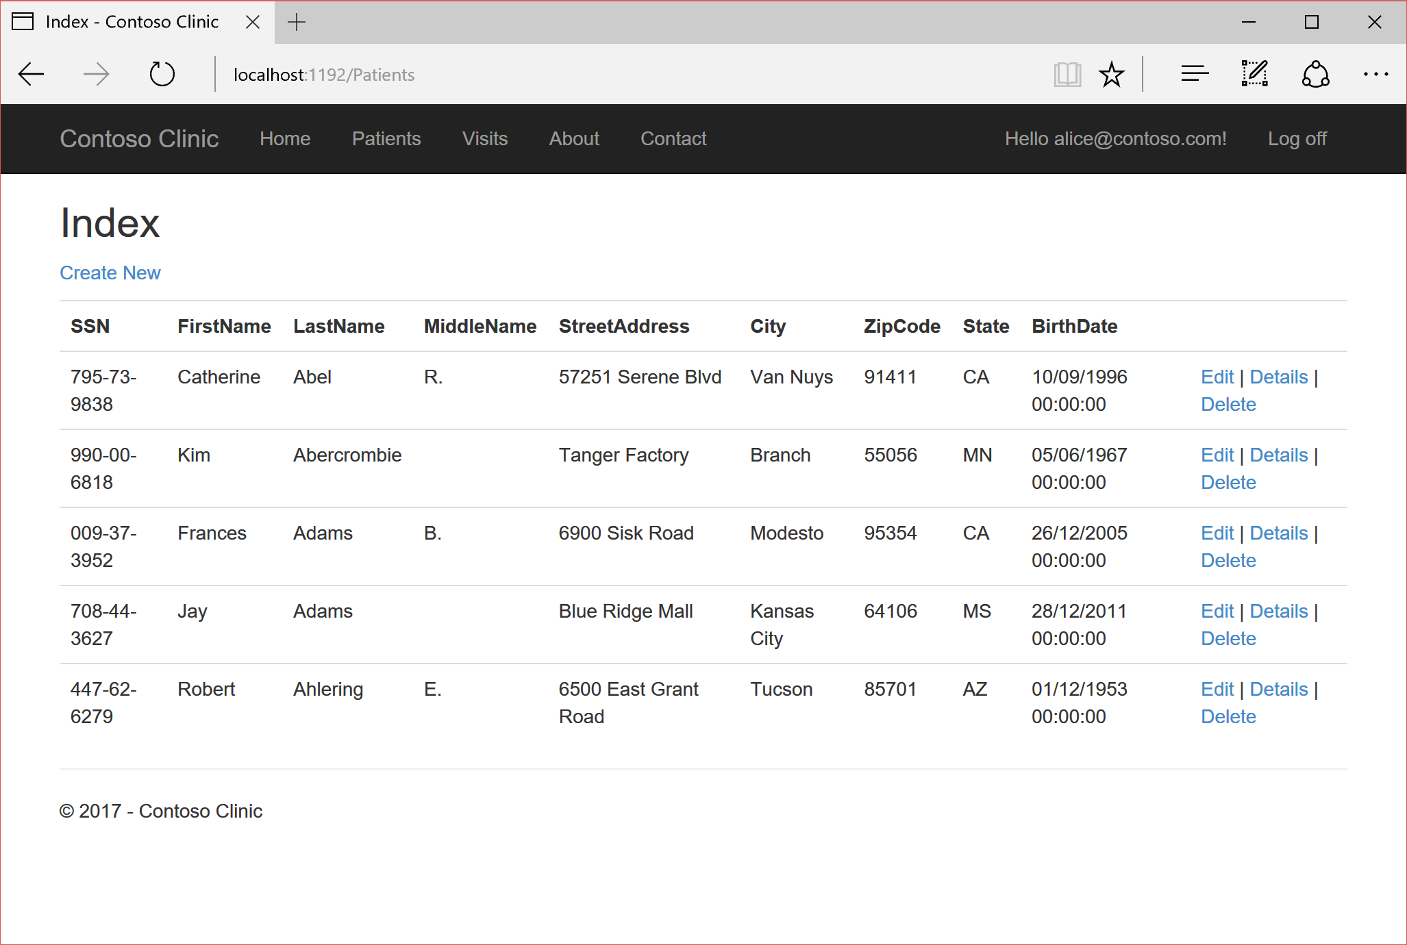
DDM: Alice patients

Slide 60
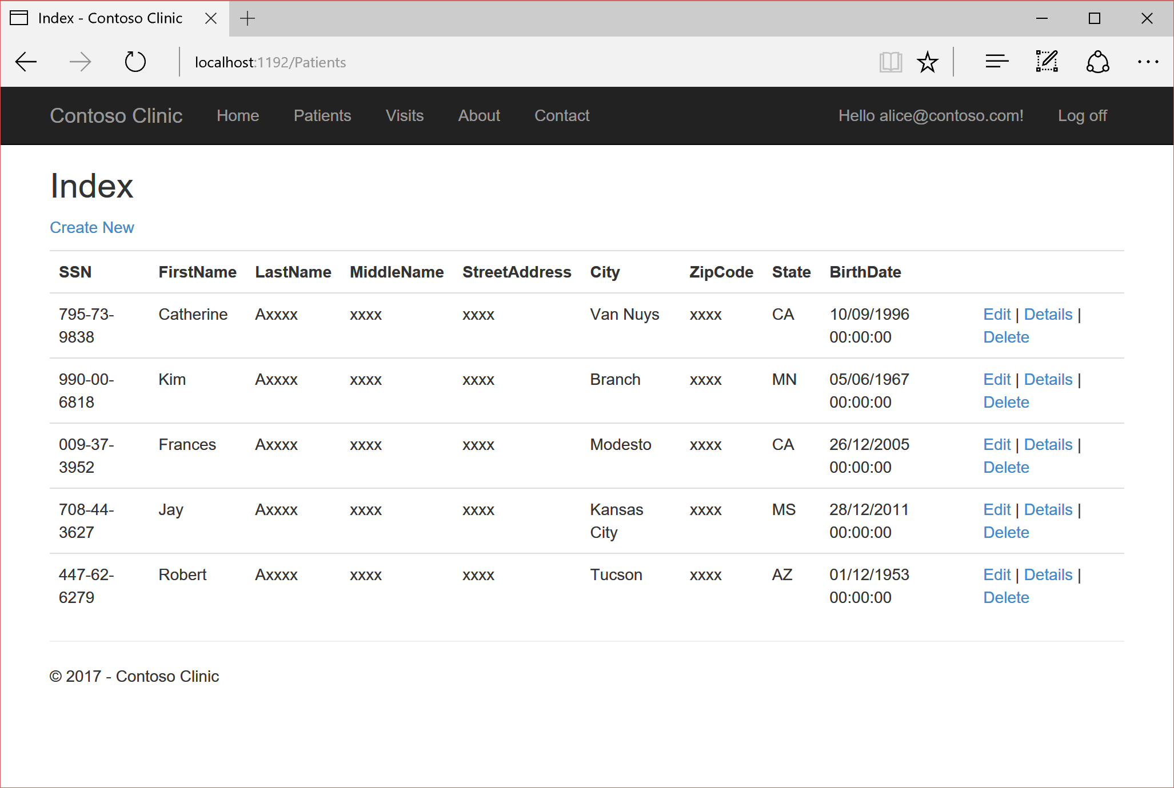
DDM: Alice patients’ data masked

Slide 61
Funzioni Dynamic Data Masking
Default
  Dipendente dal tipo ‘X’, 0, 01.01.1900 00:00:00.0000000
Email
  aXXX@XXXX.com
Random
  Intervallo di interi
Stringa Custom
  Prefix length, [padding char], suffix length

Slide 62
Permessi Dynamic Data Masking
CRATE e ALTER tabella
ALTER ANY MASK (con ALTER per la tabella)
UNMASK
Può comunque aggiornare i dati!

Slide 63
Dynamic Data Masking Gotchas
Attenzione allo spostamento di dati
  Export/Import
  SELECT…INTO
  INSERT…SELECT…FROM
Tecniche di forza bruta
  Inferenza di valori (tramite predicati su intervalli)
  Tabelle con valori di dominio

Slide 64
Limitazione Dynamic Data Masking
Tipi colonna non ammessi
  Colonne crittografate (Always Encrypted)
  FILESTREAM
  COLUMN_SET (o «sparse column» che ne fanno parte)
  Colonne calcolate (però possono referenziare mascherate)
  Colonne chiave indici FULLTEXT
READTEXT, UPDATETEXT, WRITETEXT
  Non funzionano correttamente con UNMASK

Slide 65
Continuità del servizio
SQL Server & GDPR

Slide 66
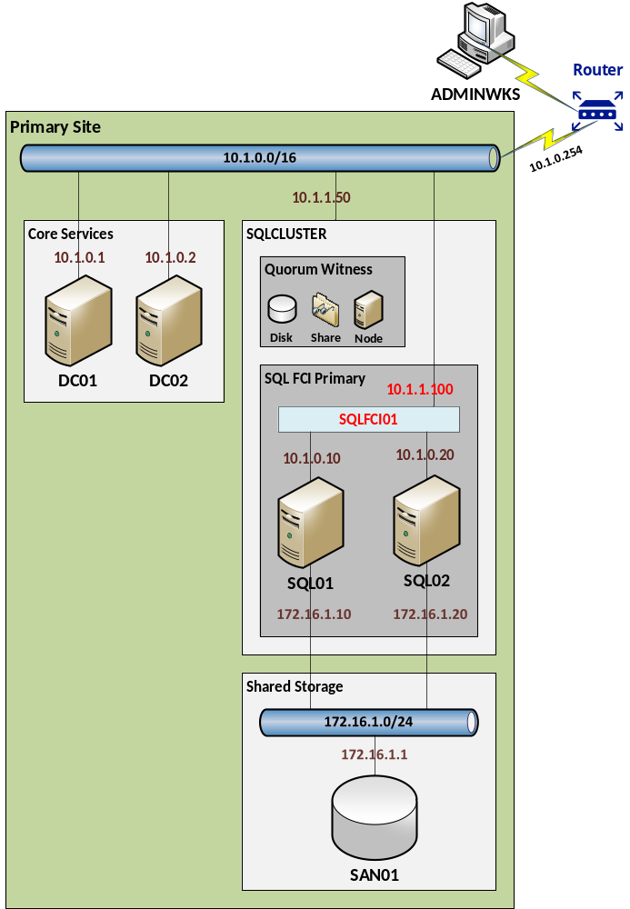
AlwaysOn Failover Cluster Instance
Funzionamento normale
Notes:
Why is this important for the GDPR?
The GDPR explicitly refers to this important aspect of protecting data, by requiring that the organization “implement appropriate technical and organizational measures” that take into consideration, as appropriate, “the ability to restore the availability and access to personal data in a timely manner in the event of a physical or technical incident”.
GDPR Article 32(1)—“Security of processing.”

Slide 67
AlwaysOn Failover Cluster Instance
Indisponibilità nodo
CRASH

Slide 68
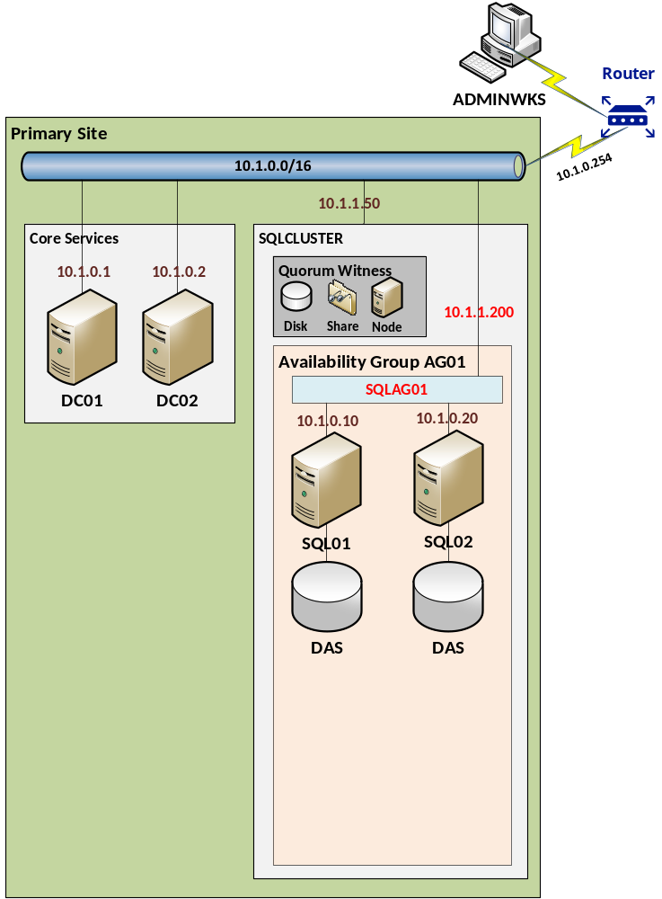
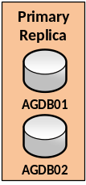
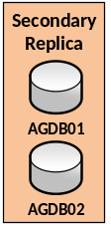
AlwaysOn Availability Groups
Funzionamento normale

Slide 69
AlwaysOn Availability Groups
Indisponibilità nodo
CRASH

Slide 70
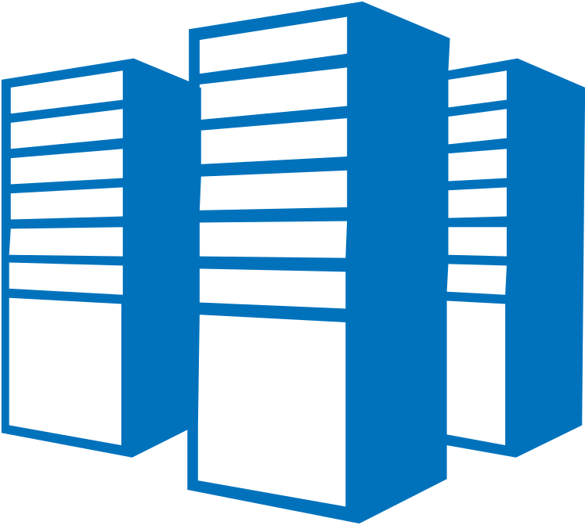

Azure SQL Database
DB
Logicamente singolo database
Ack
Read
value
write
P
S
P
Ack
Write
P
S
S
S
Write
Ack
S
Possibilità di avere repliche geografiche
  Standard 1 copia non accessibile, Active fino a 4 copie in sola lettura

Slide 71
Backup e restore
Diversi modelli componibili
  Completo (FULL), differenziale (DIFF), incrementale (LOG)
«Point-in-time»
  granularità fino a un punto in base a «retention»
  Richiede modello di recovery FULL e backup log
Possono essere crittografati
  Attenzione a non perdere le chiavi crittografiche!
  Automaticamente con TDE (default usa Database Key)

Slide 72
Backup & Restore in Azure SQL Database
Automatici
  «Full» settimanale
  «Differenziale» qualche ora
  «Log» ogni 5-10 minuti
«Backup set»
  Ridondati localmente
  Ridondati geograficamente (regione geo-politica affine)
  Long Term Backup Retention (in anteprima)
    Settimanali mantenuti per 10 anni

Slide 73
Report e revisione
SQL Server & GDPR

Slide 74
Cosa tracciare
Accessi
  SQL Server Trace (Profiler, deprecato)
  SQL Server Audit
Dati modificati (versioni precedenti)
  Change Data Capture
  Temporal Databases

Slide 75
SQL Server Audit
Definizione gruppi di azioni da tracciare
  Server
  Database
Target
  File
  Windows Log
Disponibile con tutte le edizioni
  a partire da SQL Server 2016 Service Pack 1
  Implementazione diversa per Azure SQL Database
Notes:
https://docs.microsoft.com/en-us/sql/relational-databases/security/auditing/sql-server-audit-database-engine
https://docs.microsoft.com/en-us/azure/sql-database/sql-database-auditing

Slide 76
Azure SQL Database Threat Detection
Semplice opzione da attivare per database
  Richiede attivazione «SQL Database Auditing»
Rileva potenziali minacce/vulnerabilità
  Attacchi di tipo «SQL Injection»
  Accessi anomali (es. da luoghi anomali)
Allarmi
  In tempo reale
  Raccomandazioni cosa investigare/come mitigare/rimediare
Notes:
https://myignite.microsoft.com/videos/2998

Slide 77
Policy Based Management
Infrastruttura per
  Definizione «policy»
  Controllo conformità installazione con «policy»
Serie di «policy» conformi a Best Practice
  Categoria di policy per sicurezza!
Enterprise Policy Management Framework
  http://aka.ms/epmframework
Notes:
https://docs.microsoft.com/en-us/sql/relational-databases/policy-based-management/monitor-and-enforce-best-practices-by-using-policy-based-management

Slide 78
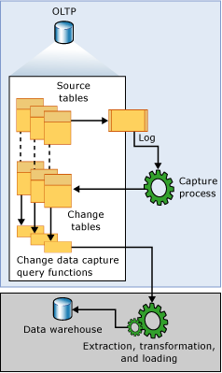
Change Data Capture
Soluzione tradizionale Audit modifiche dati?
  Trigger! Ma…
  …complessità, prestazioni… ☹
CDC cattura automaticamente modifiche
  Pensato principalmente per caricare DWH
  Genericamente va bene per tenere storico modifiche

Slide 79



Modifiche Database Temporali
«Temporal table» (dati correnti)
«History table»
* Versioni vecchie
Update */ Delete *
Insert / Bulk Insert

Slide 80
Interrogazioni Database Temporali
«Temporal table» (dati correnti)
«History table»
* Include versioni storiche
Query normali
(dati correnti)
Query temporali *
FOR SYSTEM_TIME
ALL, AS OF,
BETWEEN … AND …, FROM … TO, CONTAINED IN

Slide 81
Risorse
SQL Server & GDPR

Slide 82
Risorse GDPR
Regolamento ufficiale
  http://data.consilium.europa.eu/doc/document/ST-9565-2015-INIT/en/pdf
Guide to enhancing privacy and addressing GDPR requirements with the Microsoft SQL platform
  https://aka.ms/gdprsqlwhitepaper
Microsoft Trust Center
  https://www.microsoft.com/GDPR
  https://www.microsoft.com/it-it/trustcenter/privacy/GDPR
GRPR Detailed Assessment Toolkit
  http://aka.ms/gdprdetailedassessment

Slide 83
Risorse Security generiche
White Papers
  SQL Server 2012 Security Best Practices
    http://download.microsoft.com/download/8/f/a/8fabacd7-803e-40fc-adf8-355e7d218f4c/sql_server_2012_security_best_practice_whitepaper_apr2012.docx
SQL Server Security Blog
  https://blogs.msdn.microsoft.com/sqlsecurity
Corso MVA
  https://mva.microsoft.com/en-US/training-courses/16076
GitHub Samples
  https://github.com/Microsoft/azure-sql-security-sample
  https://github.com/Microsoft/sql-server-samples

Slide 84
Risorse Security specifiche
Transparent Data Encryption
  https://blogs.msdn.microsoft.com/sqlsecurity/2016/10/05/feature-spotlight-transparent-data-encryption-tde
Always Encrypted
  https://msdn.microsoft.com/en-us/library/mt163865.aspx
  https://channel9.msdn.com/events/DataDriven/SQLServer2016/AlwaysEncrypted
  https://channel9.msdn.com/events/Ignite/2016/BRK3151

Slide 85
Risorse Business Continuity
SQL Server 2014 From 0 to HA with Cluster & AlwaysOn
  https://www.youtube.com/watch?v=YbF17toCd5Y
Azure & SQL Server: what’s new
  https://www.youtube.com/watch?v=MfADRPjvrzo

Slide 86
Q&A

